Slide 1

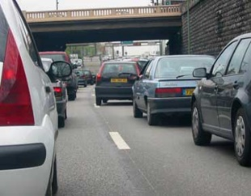




Impact sur la santé de la pollution de l’air en extérieur et en milieux fermé
Isabella ANNESI-MAESANO ^{1,2}
DR1 INSERM, Professor of Environmental Epidemiology
¹ IMMUN4CURE, INSERM and University of Montpellier, Montpellier, France
² Department of Pneumology, Allergology and Thoracic Oncology, CHUM (University Hospital), Montpellier, France
FERS, ATS Fellow
2025 Alice Hamilton Award
2021 EAACI Clemens Von Piquert Award
2018 AAAAI Phil and Barbara Liebmann Award

Slide 2
Disclosures
International
ERS: Ethics and Integrity Committee (Member)
EAACI: - ExCom (Member)
- Public, Patients & Outreach Hub (Editor in Chief)
- EU DARWIN Advisory Board (Member)
National
IRD: Ethics Committee (Member)
MEDD: Comité prévention et protection (CPP) (Member)
SFA: Scientific Committee (Member)
RNSA: Scientific Committee (Member)
Météo France: Commission Santé (Member)
Société Pneumologie Langue Française: GT PAPPEI (Member)
APPA: Scientific Council & Board of Directors (Member)
Section Editor for Environmental Health of ERJ and IJTLD

Slide 3
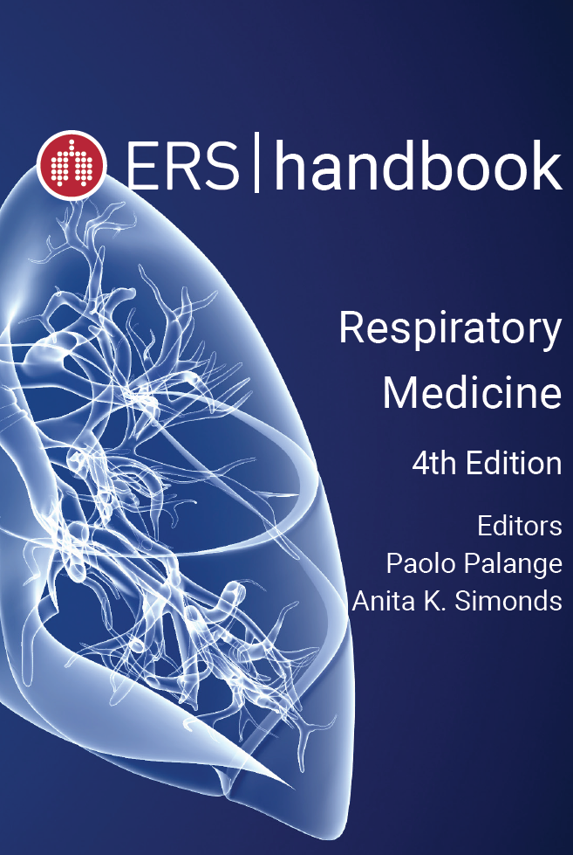
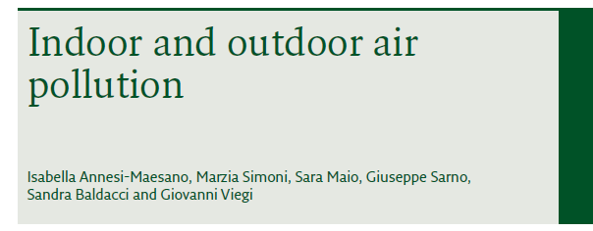
2025

Slide 4
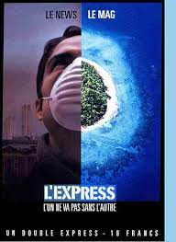
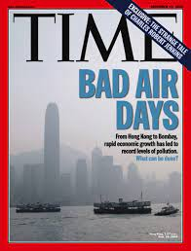
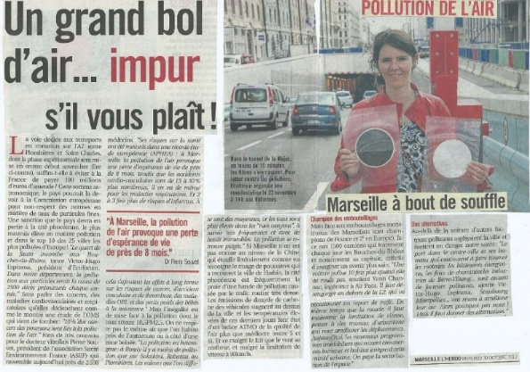
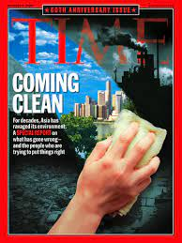
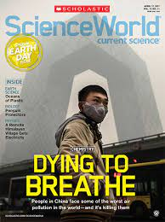
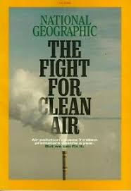
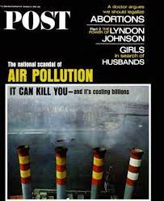

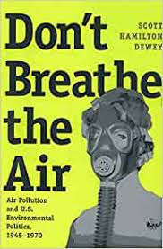
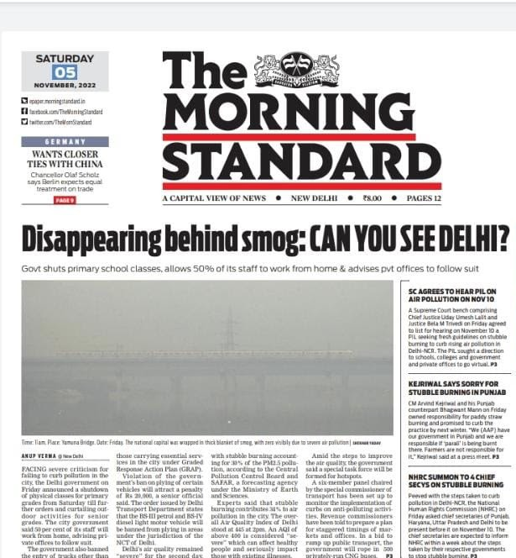
Air pollution is a major public health concern
« Air pollution is the new tobacco »
Dr Tedros Adhanom Grebreyesus
WHO Director-General
Notes:
Air pollution is the new tobacco

Slide 5
GAZ AND PARTICULATE MATTER
AIR POLLUTION IS UBIQUITOUS AND BREATHING IS A NEED!

Slide 6
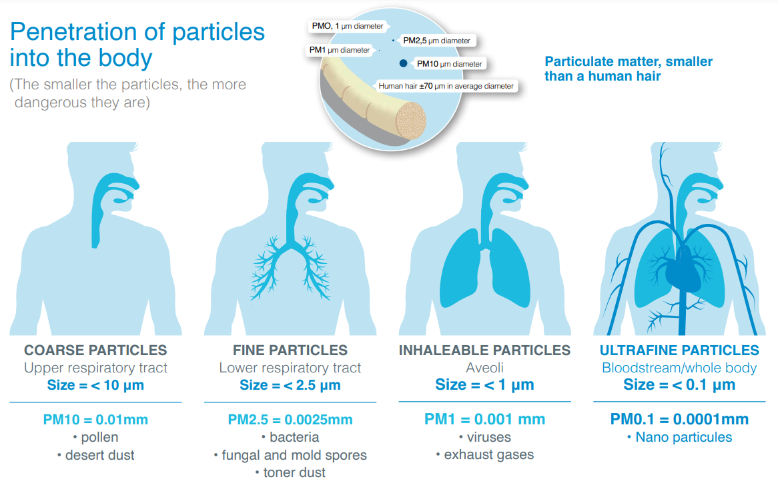
PM the big killer
Blood-brain barrier
Both PM size and composition are of concerns
Notes:
particulate matter air pollution was the leading contributor to the global disease burden in 2021, ...
La barrière hémato-encéphalique, ou hémo-encéphalique, ou hémato-méningée est une barrière physiologique présente dans le cerveau chez tous les tétrapodes (vertébrés terrestres), entre la circulation sanguine et le système nerveux central (SNC). Elle sert à réguler le milieu (homéostasie) dans le cerveau, en le séparant du sang.

Slide 7

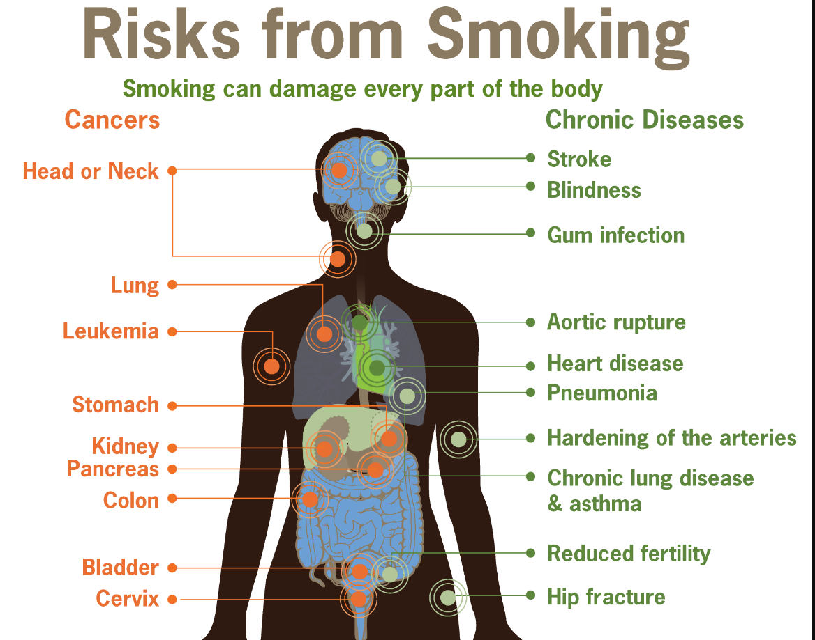
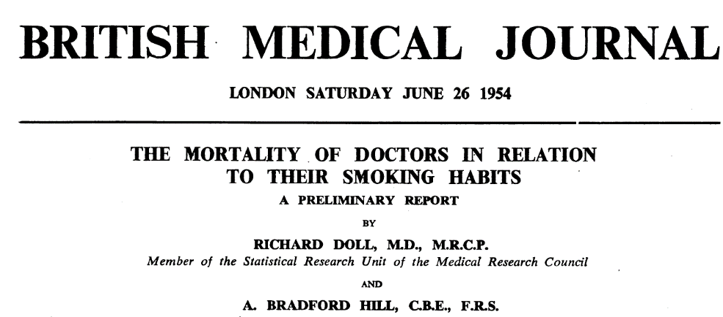
70 years ago Today
from: Tobacco Use-CDC Vital Signs -September 2010.

Slide 8
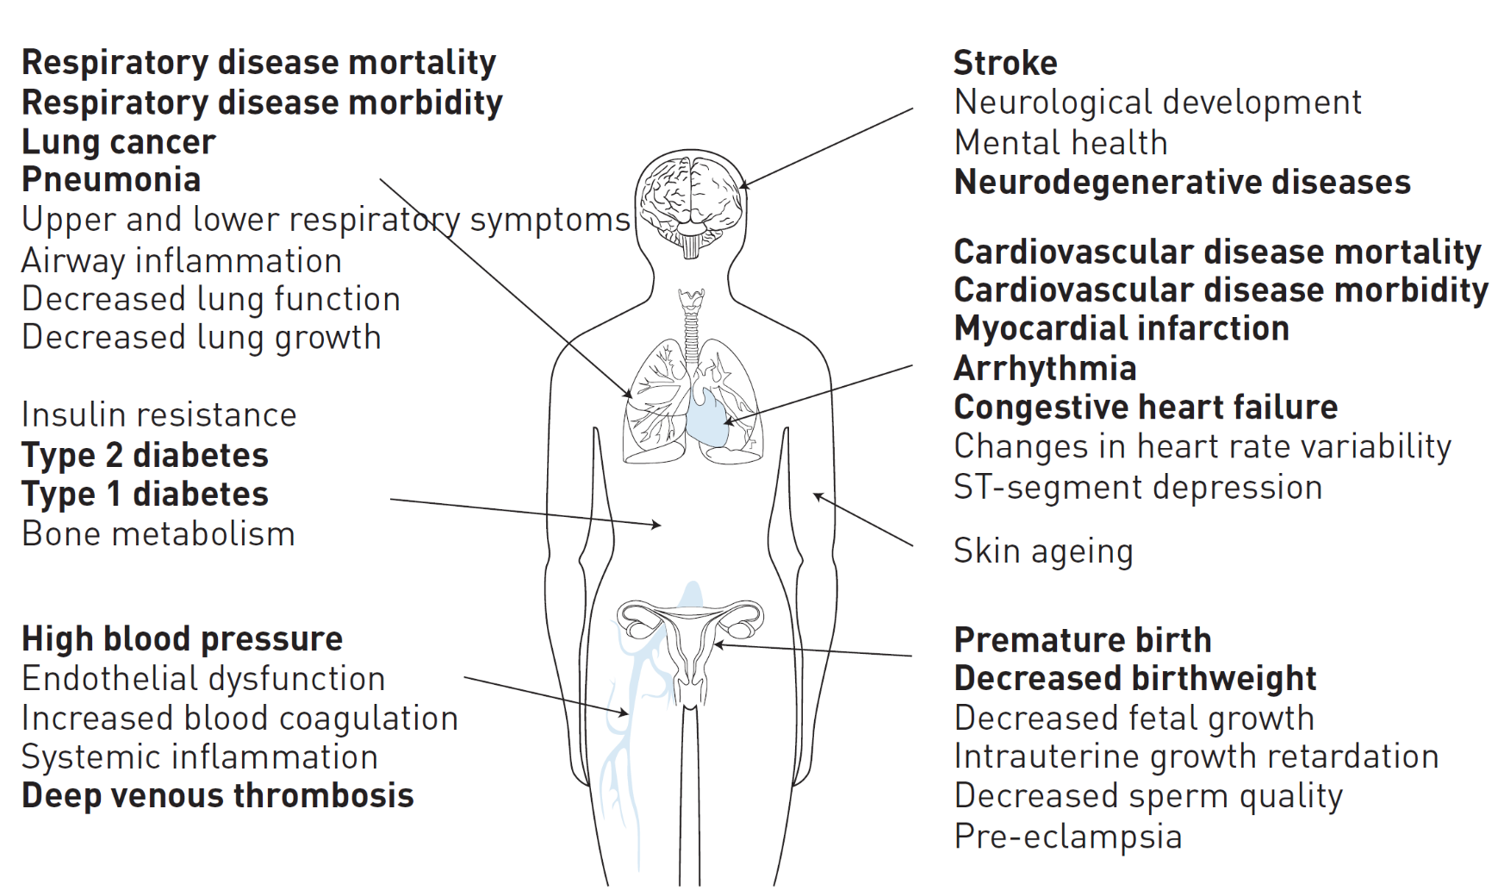
Today: Health effects of particulate air pollution
Joint ERS / ATS statement (ERJ, 2016)

Slide 9
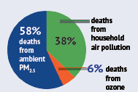
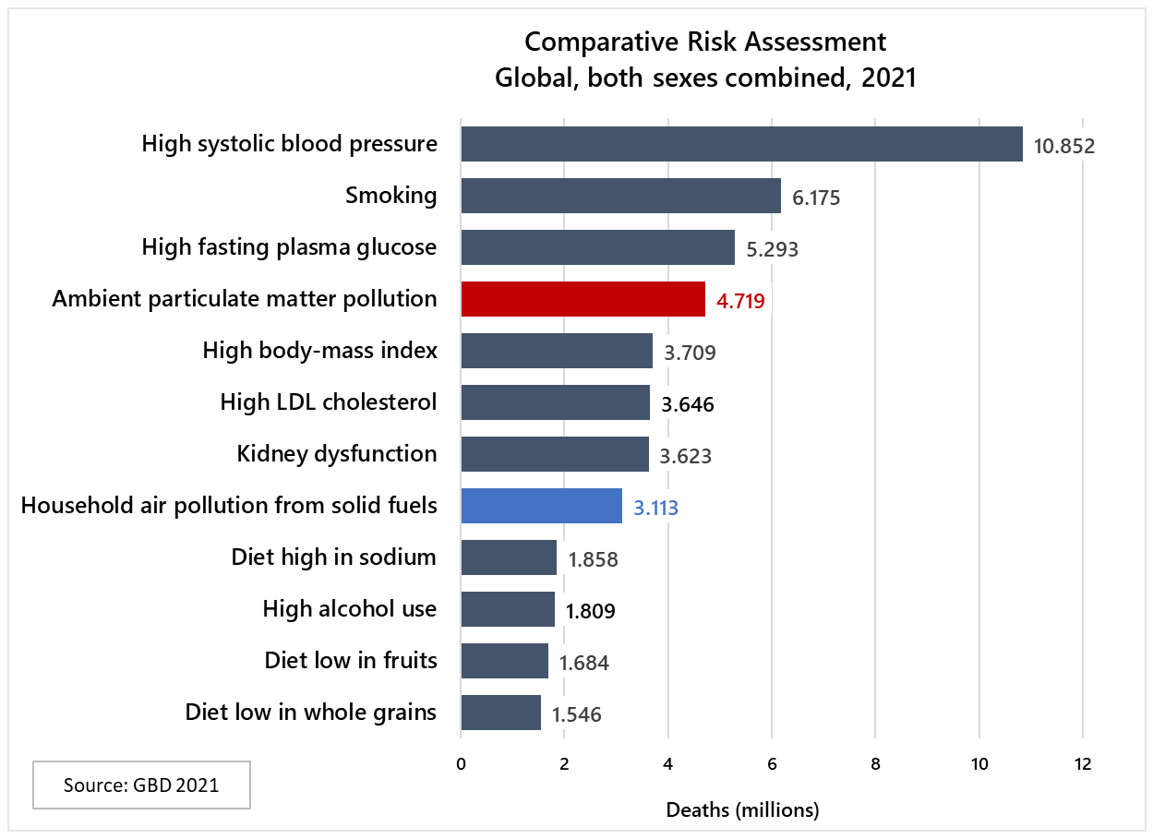
Global ranking of risk factors by total number of deaths from all causes. GBD, 2021
8.1 million total deaths due to air pollution in 2021
The second largest risk factor of deaths after blood pressure
Countries in South Asia and Africa face the highest burden
Children under 5. 709,000 total deaths from air pollution in 2021. The largest burden of disease is seen in Asia and Africa

Slide 10
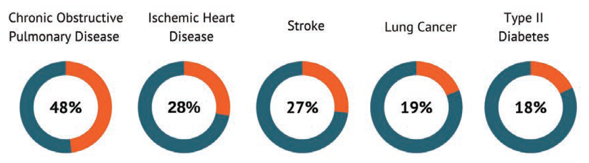
Percentage of global deaths from specific causes attributable to total air pollution in 2021
Source: State of Global Air, 2024

Slide 11
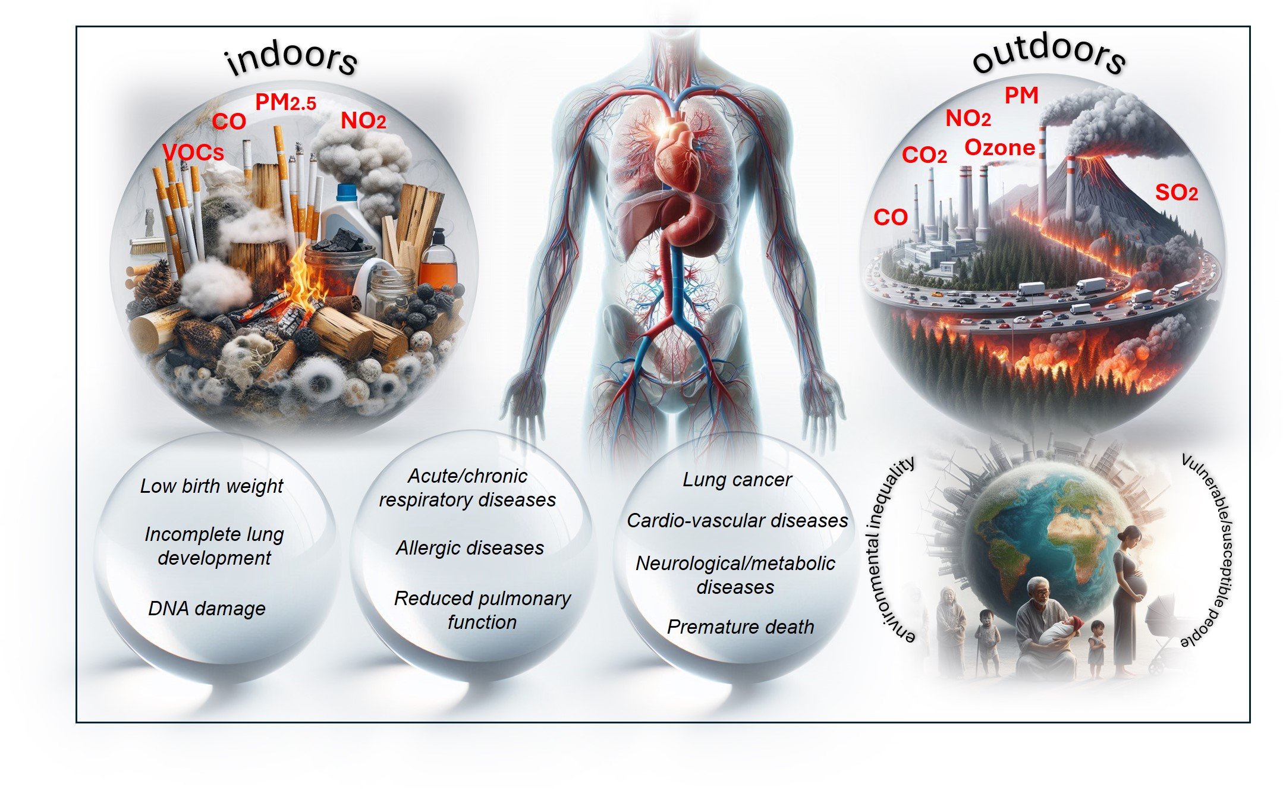
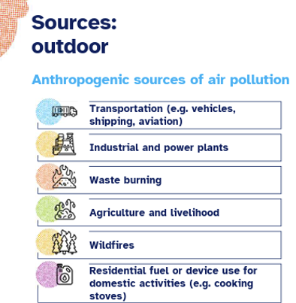
Sources and chemical air pollutants
GASES and PARTICULATE MATTER

Slide 12
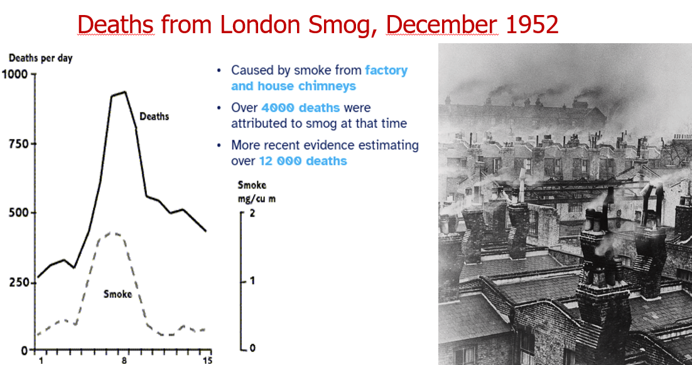
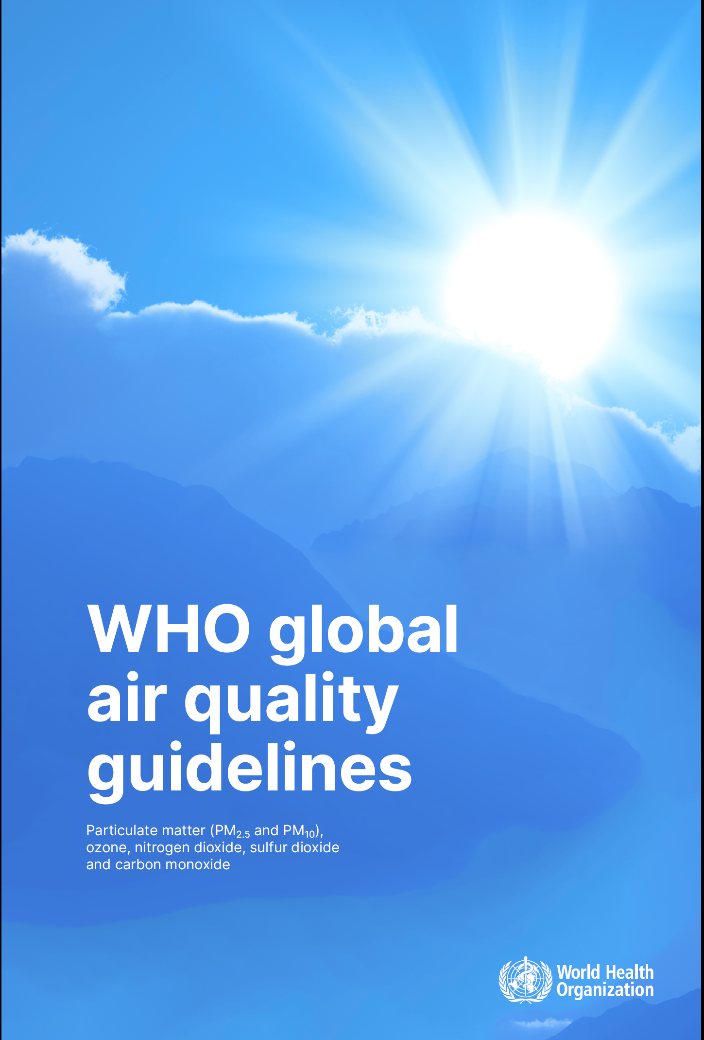
How did we get here?
A combination of large epidemiological studies and toxicological investigations

Slide 13
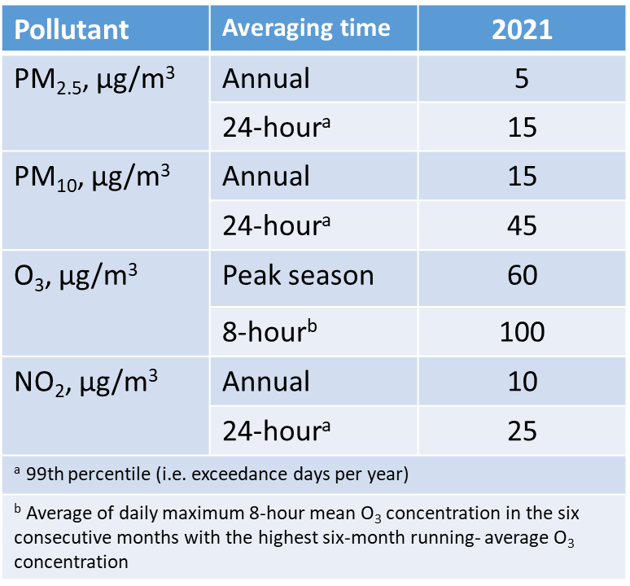
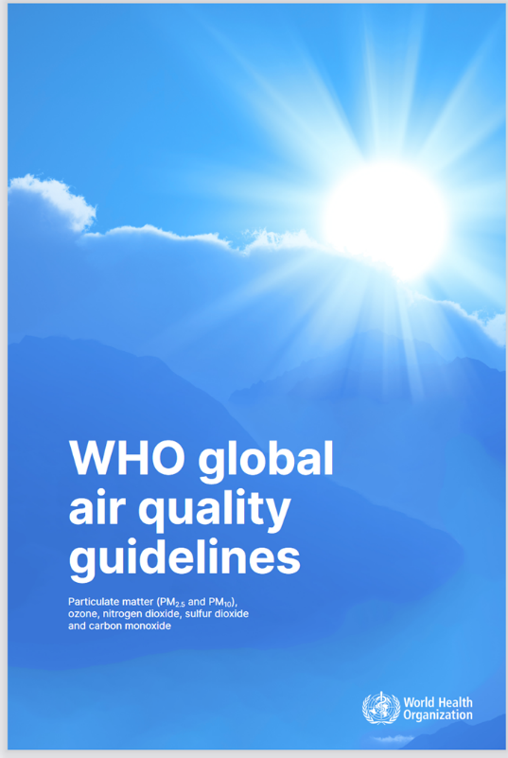
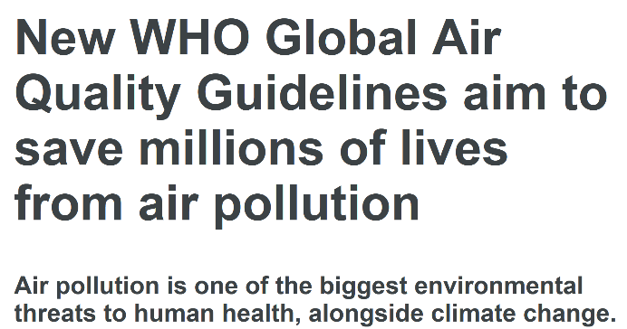
Consensus on Air Pollution and Health:
WHO Air Quality Guidelines 2021
3-4 exceedance days per year)

Slide 14
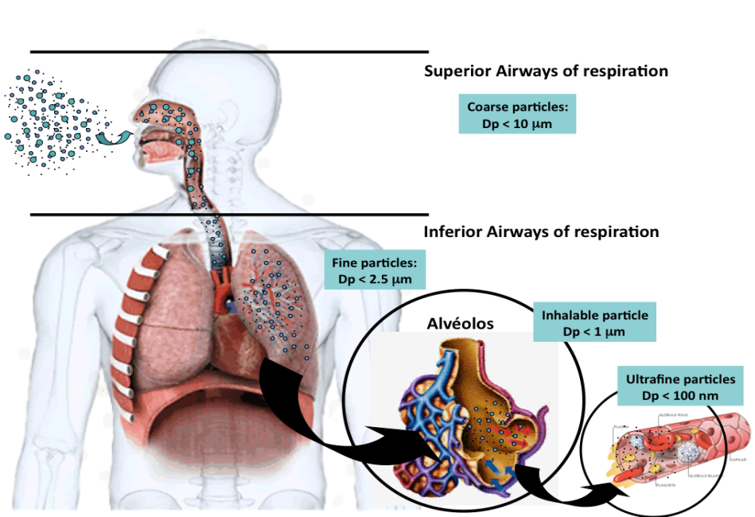
Particles: from inhalation to all organs
With each inhalation, we breathe in millions of particles
Inhaled particles travel through the respiratory tract; larger ones (>10µm) are trapped in the nose and throat, smaller ones (2.5–10µm) reach the bronchi, and fine particles (<2.5µm) penetrate deep into the alveoli. Ultrafine particles (<0.1µm) can enter the bloodstream.
Oxidative Stress, inflammation in the lung
Carcinogenic effect on the lung
Transfer of inflammatory mediators and particle components in blood stream and organs
Short- and long-term effects on nearly all organ systems
Image Source: http://www.reimaginegas.com/?p=2483

Slide 15
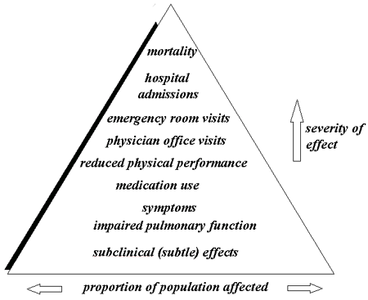
Pyramid of Health Effects of air pollution
short-term vs. long-term effects
although there is probably a continuum of effects in the time scale, which are not yet fully understood
PM can affect both the respiratory and cardiac systems.
IAM IHU Immun4CUre Montpellier, translated from Rev Mal Respir. 2020 May;37(5):389-398.
Notes:
PM can affect both the respiratory and cardiac systems. The health effects of PM can be seen as a pyramid, with the mildest but not common effects at the bottom of the pyramid, and the least common but more severe at the top of the pyramid. The pyramid demonstrates that as severity decreases the number of people affected increases.
THE EFFECTS OF AIR POLLUTION ON HEALTH ARE OFTEN CONVENIENTLY CLASSIFIED: short-term vs. long-term effects
although there is probably a continuum of effects in the time scale, which are not yet fully understood

Slide 16
OUTDOOR AIR POLLUTION HEALTHY EFFECTS

Slide 17
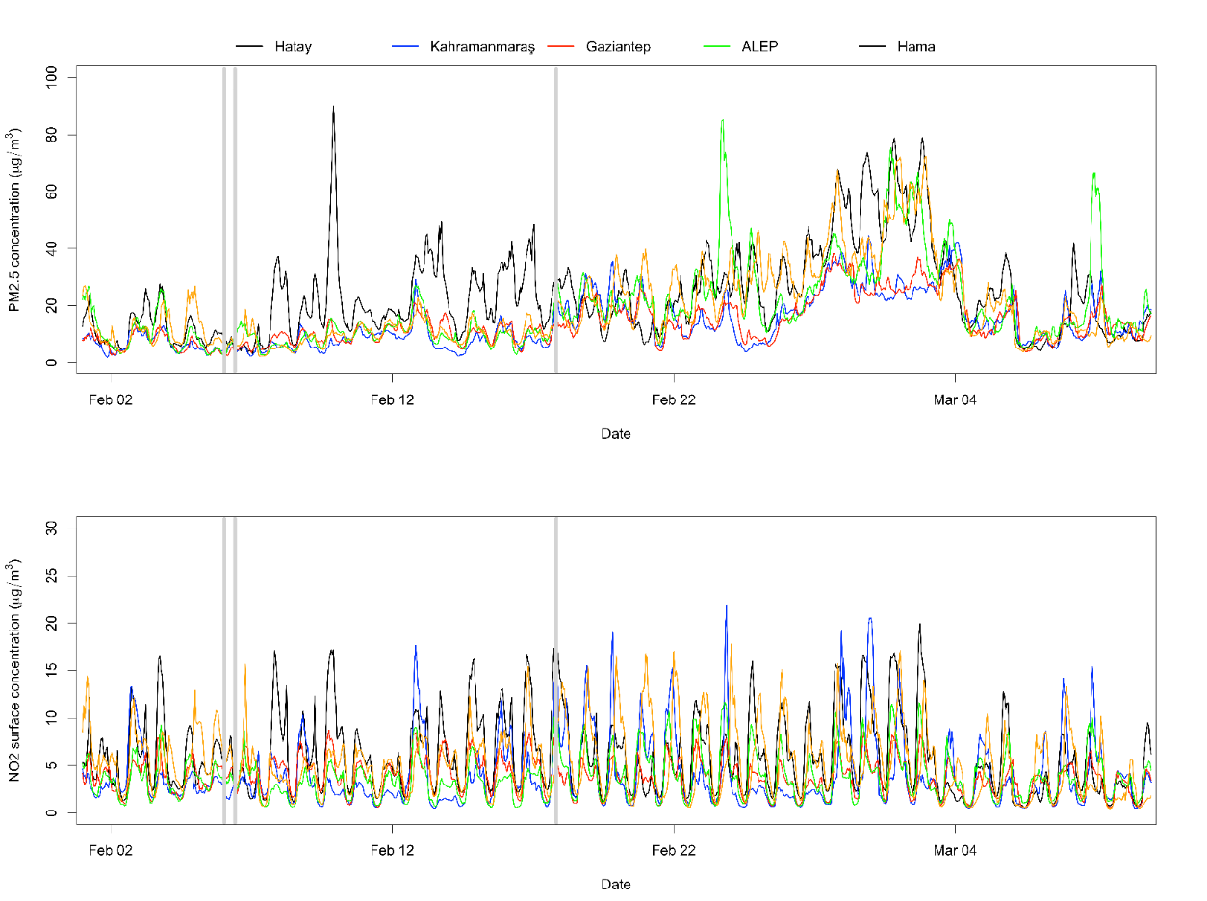
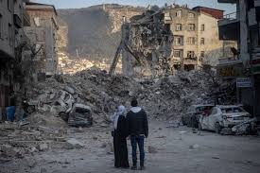
Extreme air pollution events
Earthquake Disaster and Respiratory Health: Lessons from Turkey and Syria in 2023
Yousser Mohammad, Hasan Bayram, Ozgecan Kayalar, Fabio Madonna, Isabella Annesi-Maesano, ERJ 2024
WHO
WHO

Slide 18
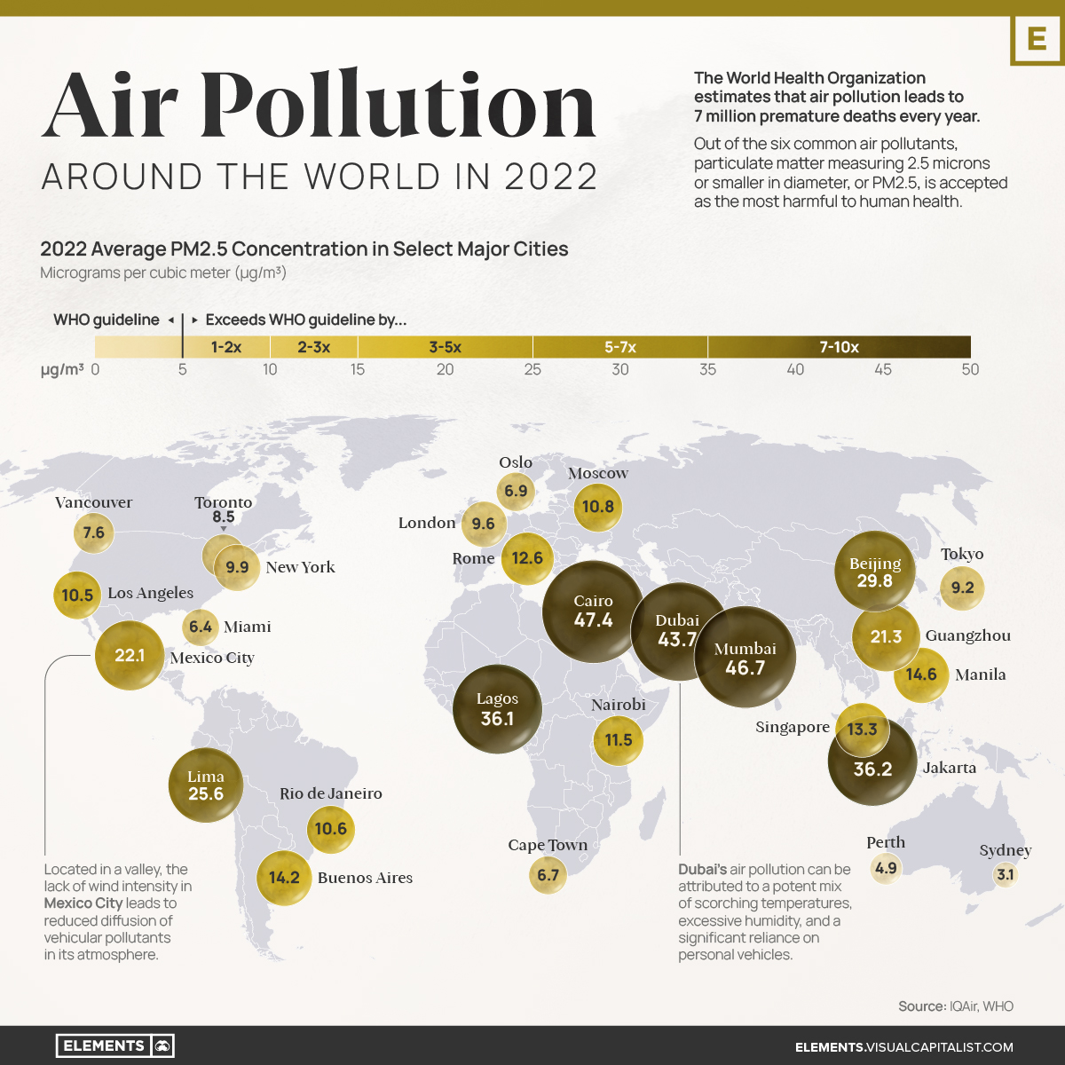
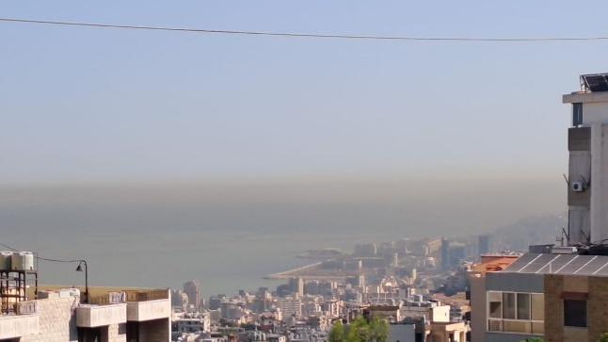
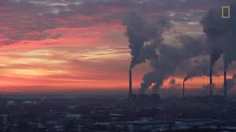
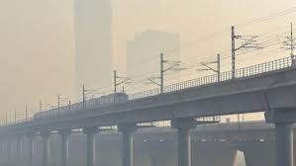
Chronic air pollution events
Air pollution in Lebanon 2023

Slide 19
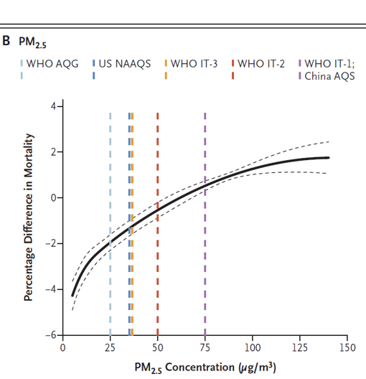
Short-term effects on mortality

Slide 20
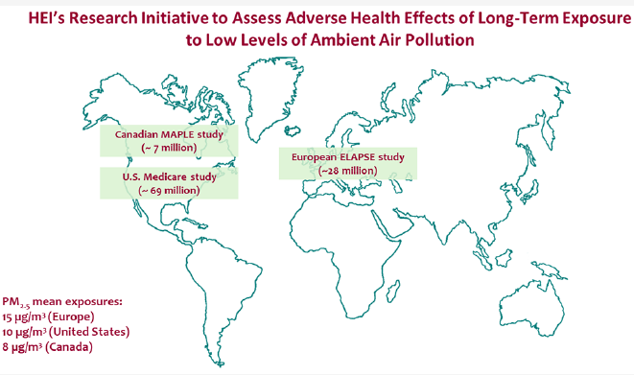
Long-term effects on mortality
The «low-level» HEI-funded cohort studies
Boogaard et al, 2024

Slide 21
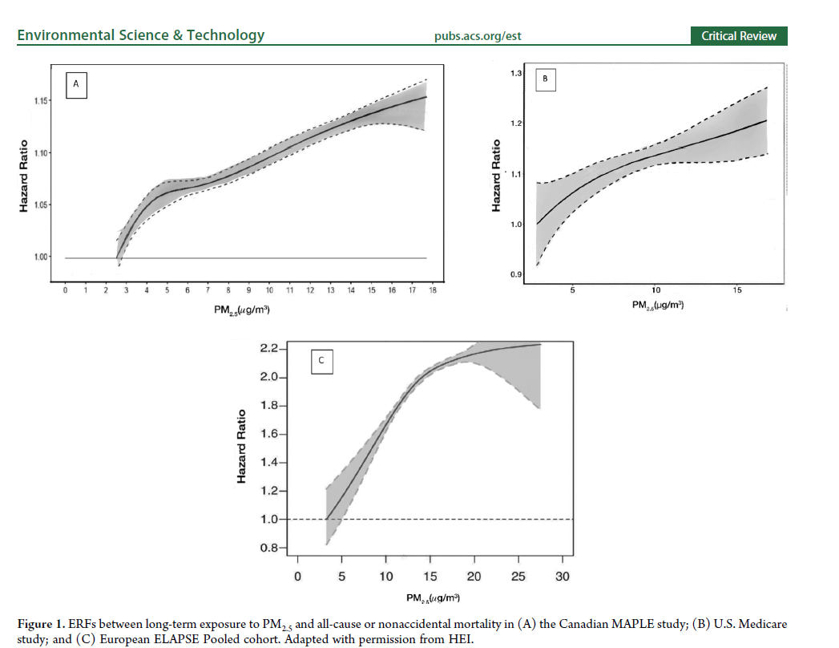
Long-term effects on mortality
Canada, Maple
USA, Medicare
Boogaard et al, 2024
Europe, Elapse

Slide 22
Causality determinations on long-term effects of air pollutants from the US-EPA Integrated Science Assessments
Category | PM_{2.5} (EPA 2019) | NO₂ (EPA 2016) | Ozone (EPA 2020)
Reproductive and developmental effects | Suggestive | Suggestive | Suggestive
Respiratory effects | Likely | Likely | Likely
Cardiovascular diseases | Causal | Suggestive | Suggestive
Metabolic effects | Suggestive | Suggestive | Suggestive
Neurological effects | Likely |  | Suggestive
Cancer (lung cancer) | Likely (a) | Suggestive | Inadequate
Mortality | Causal | Suggestive | Suggestive
(a) IARC 2013: PM_{2.5} and PM₁₀ exposure is carcinogenic to humans (Group 1)

Slide 23

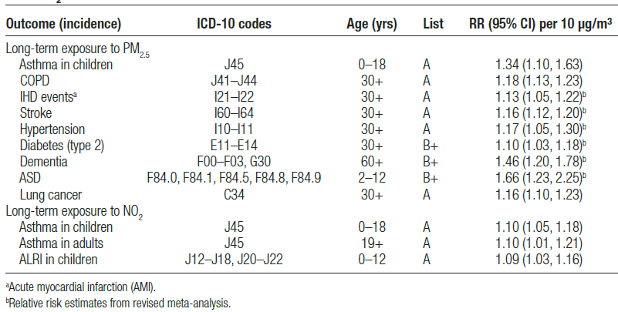
EMAPEC: Concentration-response functions of long-term exposure to air pollution and morbidity
Forastiere et al, Environmental Epidemiology, 2024

Slide 24

Air Pollution and IPF
Onset of the disease
Onset of symptoms
Diagnosis
1 yr
2 yrs
3 yrs
4 yrs
5 yrs
6 rss

Slide 25
Air Pollution and IPF
NO₂
Incidence
Conti et al. ERJ 2019
Shull et al. Respirology 2020
Onset of the disease
PM₁₀, PM_{2,5}
Acute Exacerbation
Johannson et al. ERJ 2014
Sesé et al. Thorax 2018
Dales et al. Chest 2020
Tahara et al Respir Res 2021
Onset of symptoms
O₃
PM₁₀, PM_{2,5}
Diagnosis
NO₂
Accelerated or lower functional decline
Winterbottom et al Chest 2018
Johannson et al Chest 2018
PM₁₀, PM_{2,5}
Progression
Death
Sesé et al. Thorax 2018
Yoon et al. ERJ 2020
Aguilar et al. JIMR 2021
PM₁₀, PM_{2,5}
NO₂
1 yr
2 yrs
3 yrs
4 yrs
5 yrs
6 rss
Notes:
Here you have some of the studies having found significant
For Johannson: Air Pollution Exposure Is Associated With Lower Lung Function, but Not Changes in Lung Function, in Patients With Idiopathic Pulmonary Fibrosis

Slide 26
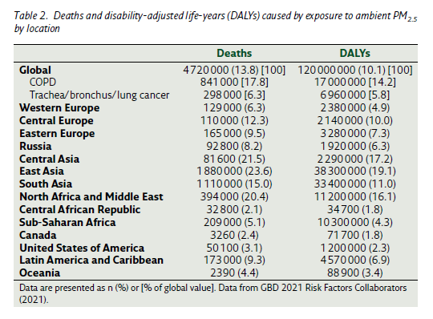

Slide 27
INDOOR AIR POLLUTION

Slide 28
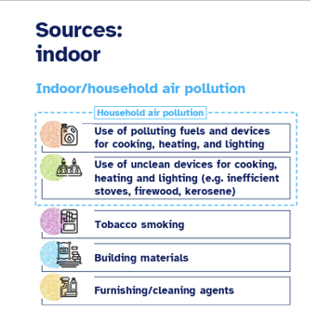
Sources and chemical air pollutants
Indoor air pollution is a major contributor to respiratory diseases
(asthma, COPD, infections), cardiovascular disease, adverse
pregnancy outcomes, and cancer, with emerging evidence for neurological impacts.
But other investigations are needed.

Slide 29
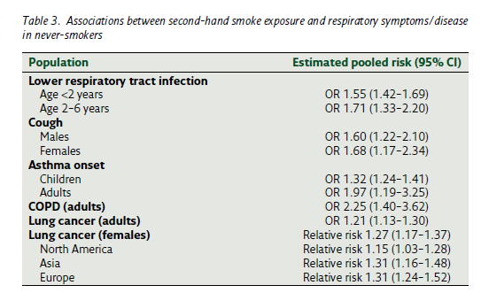

Slide 30
PROJECTIONS

Slide 31
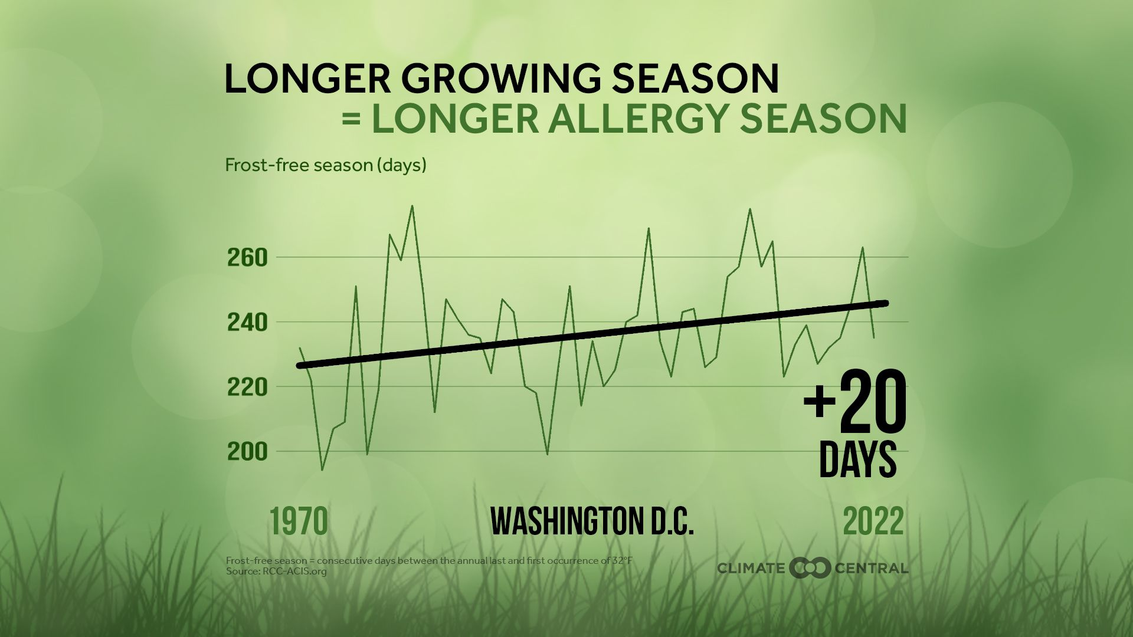
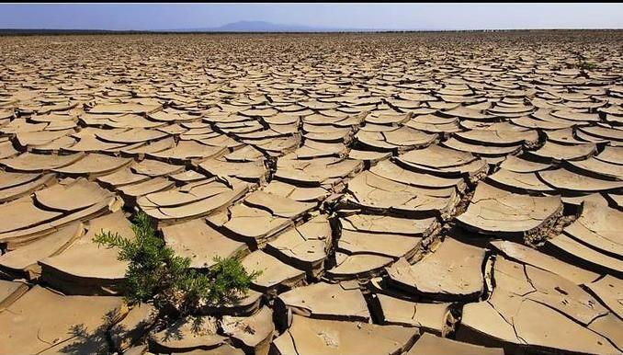
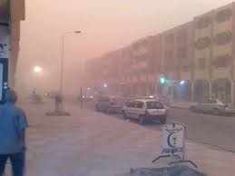
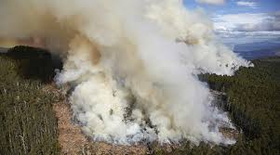
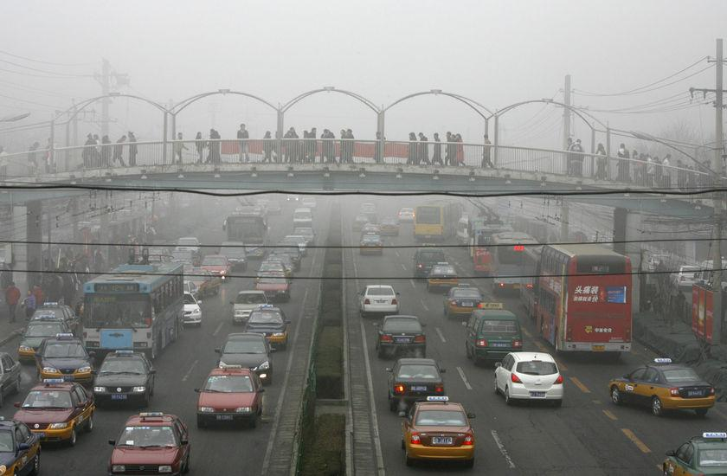
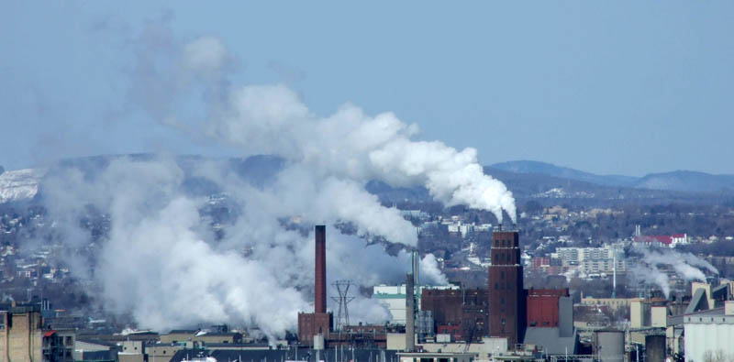
CLIMATE CHANGE-RELATED AIR POLLUTION TRENDS
Virtually certain
  Increased extended pollen seasons and pollen production and allergenicity and due to
    Increasing temperatures
    Plants moves
  Increased outdoor ozone level due to
    Increasing temperatures
    Windiness and stagnant air conditions
    Urbanization
    Natural sources of air pollutant emissions (→biogenic VOCs)
  Increased outdoor PM level due to
    Increasing emissions from
      fossil fuel-fired power plants due to demand for electricity for cooling (due to temperature increase)
      Urbanization and traffic
    Increasing natural sources of air pollutant emissions
      Wildfire smoke induced by drought and heat
      Desertification → Sand stormplants
To be further confirmed
  Increase of indoor air pollutants
Desertification
Sand storm
Wildfire
Urbanization and trafic
Industry in developing
countries

Slide 32
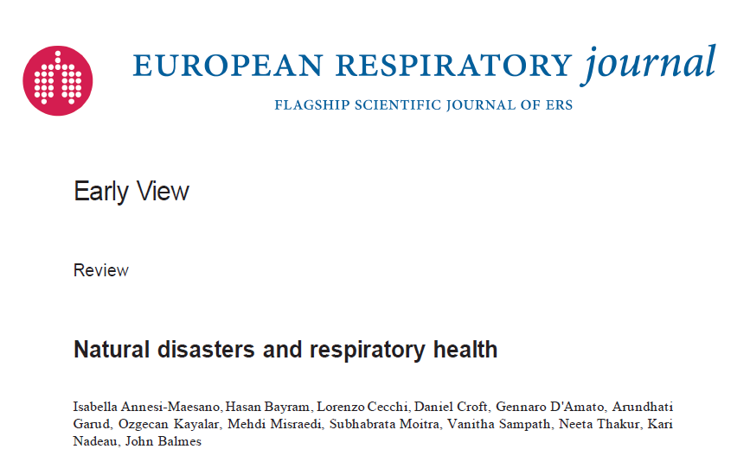


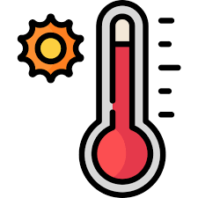



NATURAL: PM, Sulphur dioxide, VOCs, metals, PAHs, biocontaminants, etc.

Slide 33
WHAT CAN WE DO?

Slide 34
Improvements in respiratory morbidity of COPD after interventions to reduce indoor pollution
A first environmental intervention study in patients with COPD suggested that improvement of air quality can improve symptoms in these patients.
  A blinded randomized controlled trial reported a significant difference in St. George’s Respiratory Questionnaire score between a group using a portable high-efficiency particulate air (HEPA) filter and a control group using a sham filter for 6 months.
  Hansel et al. Am J Respir Crit Care Med. 2022;205:421–30.

Slide 35
Outdoor air pollution and the burden of childhood asthma across Europe
66 600 (11% of total cases) and 2400 (0.4%) childhood asthma cases per year could be prevented by complying with the World Health Organization (WHO) air quality guideline for PM2.5 and NO2, respectively
Khreis et al. Eur Respir J 2019 Oct 31;54(4):1802194
Notes:
Using data from 65 238 682 children in 18 European countries, show that a significant proportion of childhood asthma cases may be attributable to outdoor air pollution, and that these cases could be prevented. More in detail, the study reveals that 66 600 (11% of total cases) and 2400 (0.4%) childhood asthma cases per year could be prevented by complying with the World Health Organization (WHO) air quality guideline for PM2.5 and NO2, respectively.
At the world level, 194 countries and 125 major cities: 4 million new paediatric asthma cases could be attributed to NO2 pollution
annually, 64% of which in urban centres.

Slide 36
A long terme
Interdiction du diesel à Tokyo en 2003 - maintien à Osaka
Déclin NO2 similaire Tokyo vs Osaka
Mais déclin plus important à Tokyo des PM 2,5
Après ajustement sur les taux de mortalité standardisés pour l’âge à Osaka
Le pourcentage de changement entre les 3 premières années (Octobre 2000 à Septembre 2003) et les 3 dernières années (Octobre 2009 à Septembre 2012) :
Toutes causes - 6%
Causes cardio-vasculaires -11%
Cardiopathies ischémiques -10%
Maladies vasculaires cérébrales - 6%
Maladies pulmonaires - 22%
Cancer du poumon - 5%
Yorifuji T, Kashima S, Doi H. Fine-particulate Air Pollution from Diesel Emission Control and Mortality Rates in Tokyo: A Quasi-experimental Study. Epidemiology. 2016;27(6):1.
Gauderman et al. N Engl J Med 2015 Mar 5;372(10):905-13

Slide 37
Economic and societal burden from air pollution is high
Joint Statement by Medical, Public Health and Scientific Societies
Costs from disease burden
Beneficial cost-benefit-ratio for clean air policies
Hoffmann et al. Int J Public Health. 2021; 66: 1604465

Slide 38










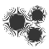

















Approaching the exposome to better understand human health
Soil and water pollution
Green, gray, blue spaces
Noise, radiations, electromagnetic waves
Outdoor air pollution
Air Pollution
Health care access
Heat-waves & wildfires
Indoor air pollution, ETS:
Urbanization
Transportation
Climate Change
Emergent products*
Climate Change
Allergens, pollen, molds
Plastics, PFA, phthallates
Diet
Excercise
Smoking
Alcohol
Drugs
Medications
Thunderstorms & floods
Lifestyle
Biocontaminants: Viruses, bacteria, fungi
Coldspells
Biodiversity Loss
Occupation
SES
Migration
Genetic/Epigenetic Alterations
Human health
More susceptible/
vulnerable individuals
ETS: Environmental Tobacco Smoking; *: plastic, PFAS, etc.

Slide 39


Asthma and allergy modifiable exposome related to climate change
Taking into account the exposome
Major impact
Diet
Health-care access
Active and passive smoking
Biodiversity loss
Physical Activity
Air pollution
Behaviour
Indoor and outdoor molds
Individual toxicants
Other allergens*
Mobility
Pollen
Individual level
Occupation
Built environment
Community/Population level
Infections (SARS-COV2)
Vitamins/
antioxydants
Social and mass media
Minor impact
Climate change related factors plotted along axes to include their relevance in asthma and allergy (minor to major) and the ability to control these factors at the individual, community and population levels through (in red) mitigation or adaptation
*: HDM, pets, pest that depend on climate

Slide 40












EXPOSOMFPI
Investigateur Principal : Dr Sesé
Responsable scientifique: Pr Nunes
Cohorte nationale multicentrique
FPI : n = 200 (avril 2021)
Suivi prospectif 2 ans
Equipe 1 : Recherche clinique
Pr Nunes, Pr Planès, Dr Gille, Pr Levy, Pr Ziol, Pr Cottin, (URC, CRB, CRMR Orphalung, INSERM U-1272)
Equipe 2 : Pollution de l’air / Exposome
Pr Annesi Maesano (INSERM UA-1318, IDESP) Boris Dessimond
Equipe 3 : Expositions professionnelles
Pr Paris, Pr Jouneau, Pathologies professionnelles et environnementales (INSERM U-1085)
Equipe 4 : Sociologie
Pr Rosental, Dr Cavalin (CNRS, Sciences Po Paris)
OBIWAN
EXPOSOMFPI
Biobank

Slide 41





OBIWAN-FPI: OBjects In Wide Area Network for IPF
Etude de l’impact de la pollution individuelle (intérieure et extérieure)
sur l’évolution de la fonction respiratoire dans la FPI
Investigateur Principal : Dr Sesé
Etude pilote monocentrique
FPI : n = 30
Suivi prospectif : 1 an
Partenaires :
Pr Nunes, Pr Annesi Maesano, Dr Gille, Pr Planès, M. Dessimond
Association de patients : APEFPI
Objets connectés

Slide 42
INEQUITIES

Slide 43

Air Pollution Harms Everyone, But Some Are at Greater Risk
Babies and children
Pregnant women
Elderly
Chronic disease patients, eg patients with
  Asthma, COPD, IHD, Heart failure, Diabetes, Cancer….
People with lower socioeconomic status (more likely to live in air pollution hotspots areas, poorer access to health care, poorer lifestyle, etc.)

Slide 44



Les enfants plus fragiles?

Slide 45

The various impacts of air pollution
Health
Environment: biodiversity, crops
Climate change
Built environment
Economic costs
Further information: WHO webpage

Slide 46

Air pollution and SES
Socially disadvantaged groups are likely to live in areas with higher levels of air pollution.
Precariousness can potentiate the deleterious effect of exposure

Slide 47

CalEnviroScreen 3.0 (CES) quantifying environmental burden combining population, environmental and
pollution vulnerability
In IPF patients:
Higher environmental exposures and vulnerability (CES) associated with:
  lower baseline lung function and lower antifibrotic use
  mortality (but not in sensitivity analyses)

Slide 48


Activities to Stop (left, red background) and Activities to Start (right, blue background) to Address EJ in the Climate Change era
Vulnerable individuals are more exposed to environmental hazards
Annals ATS 2025

Slide 49
Take-Home Messages
Air pollutants come from different sources → most are not known
Air quality has improved along the years → but not everywhere and WHO limits are not respected
The weight of some sources is increasing → biomass and wood emissions and concentrations are increasing even in Western Lifestyle countries
the adverse effects of many air pollutants are not known
Air quality health impacts are seen even at low concentrations. It is an important contribute to asthma
The health impact seems to be higher in most deprived regions and peoples (data not shown). But trends potential threshold or saturation effects in socio-environmental stressor synergism
Air pollution is not an isolated risk factor. An exposomic approach is needed to better understand its role.
Idenfying and acting on the modifiable/avoidable exposome is redibitory to improve public health.

Slide 50


Slide 51

















To my PhD students
Since 2015
isabella.annesi-maesano@inserm.fr

Slide 52


EAACI PLANETARY HEALTH APPROACH: Key Pillars
Notes:
Key Pillars of Planetary Health. EAACI’s Planetary Health framework is built on three interdependent pillars: Environmental Threats, Health Consequences, and Strategies for Mitigation and Adaptation.

Slide 53

EAACI Decalogue on Planetary Health, Asthma,
Allergies and Immunological Diseases
Notes:
EAACI Decalogue on Planetary Health, Asthma, Allergies and Immunological Diseases. A ten-principle framework demonstrating the interaction between environmental exposures and allergic or immune-mediated conditions in the context of planetary health.

Slide 55
Health impacts are unfairly distributed
Cumulative emissions of greenhouse gases
Sharp increase in greenhouse gas (GHG) emissions began with the Industrial Revolution in the late 18th and early 19th centuries.
WHO estimates of per capita mortality from climate change
Map projections from Patz et al, 2007; WHO, 2009.
How does climate change affect health?

