Slide 1


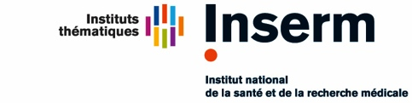
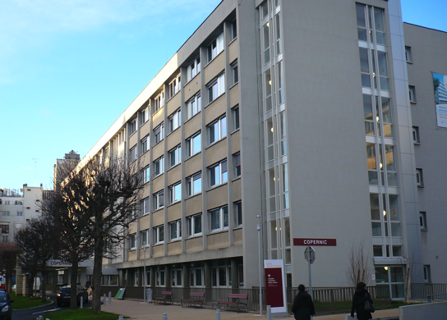
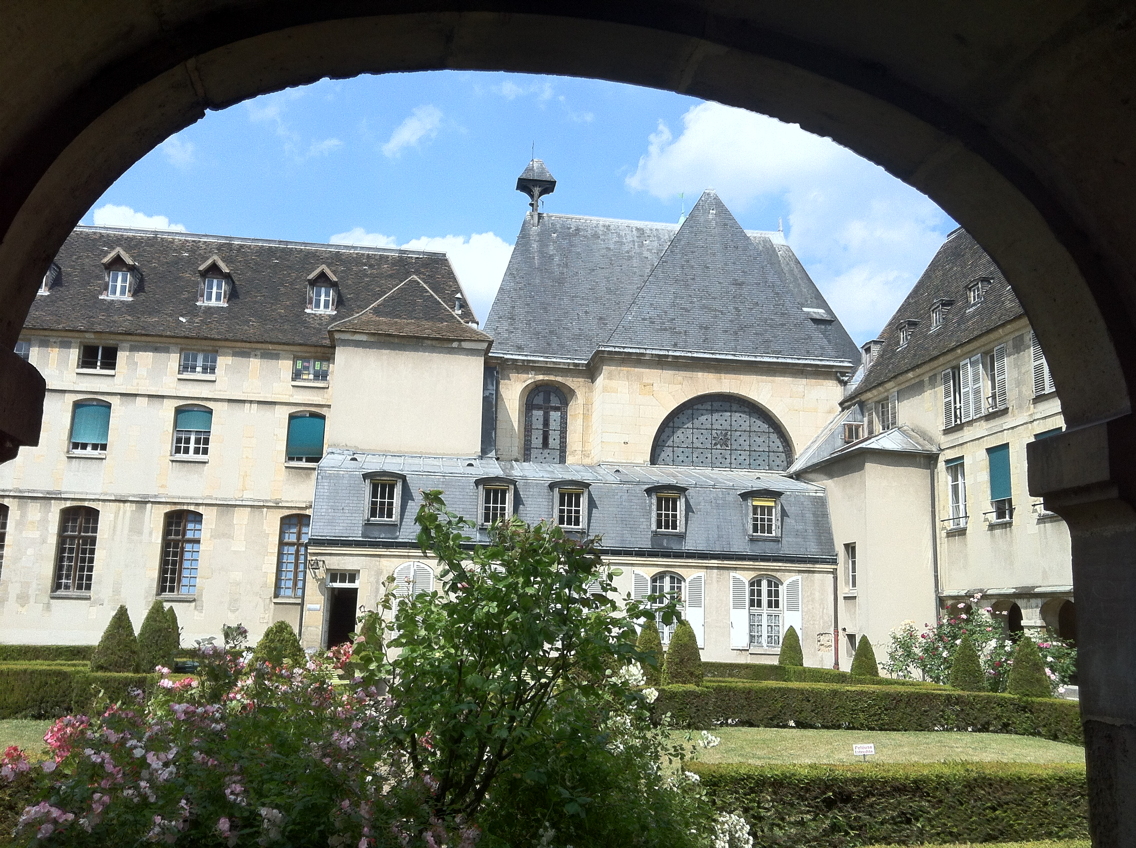

Impact des perturbateurs endocriniens sur la santé
Symposium CREER
Boulogne-Billancourt
20 Sept 2025
Prof. Jérôme BERTHERAT
Endocrinology Dpt., Cochin Hospital
Endocrinology, Metabolism & Diabetes Dpt., Cochin Institute, Paris Cité University

Slide 2
Disclosure statement
 I have the following potential conflicts of interest to report:
Research Contracts: HRA Pharma RD, Recordati RD, Neurocrine
Consulting: HRA Pharma RD, Recordati RD, Crinetics
Speaker: HRA Pharma RD, Recordati RD

Slide 3

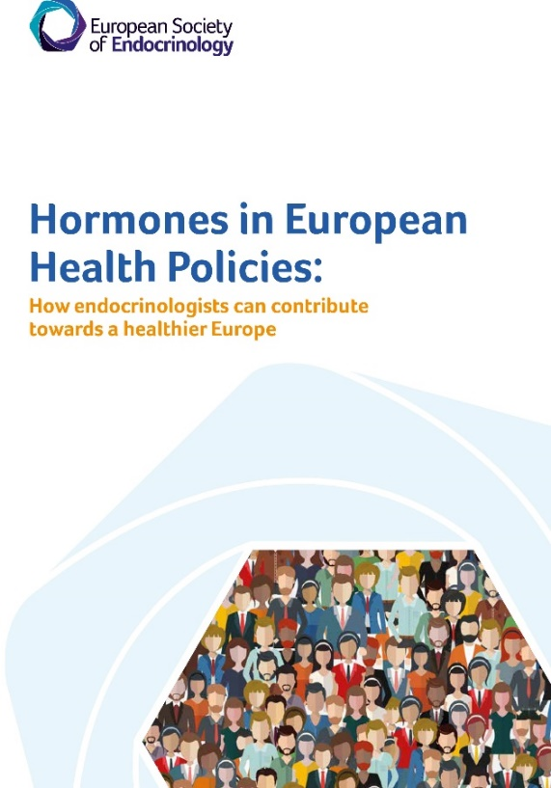

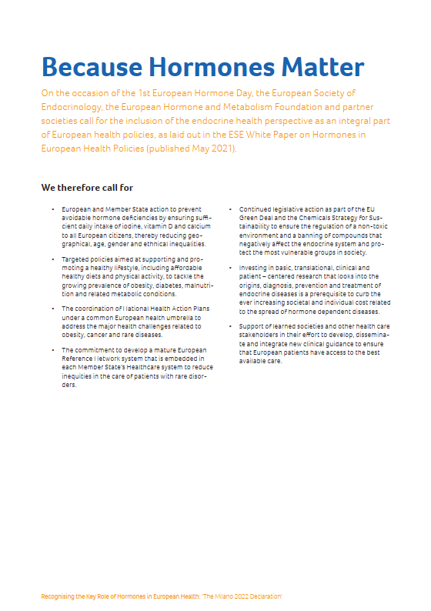
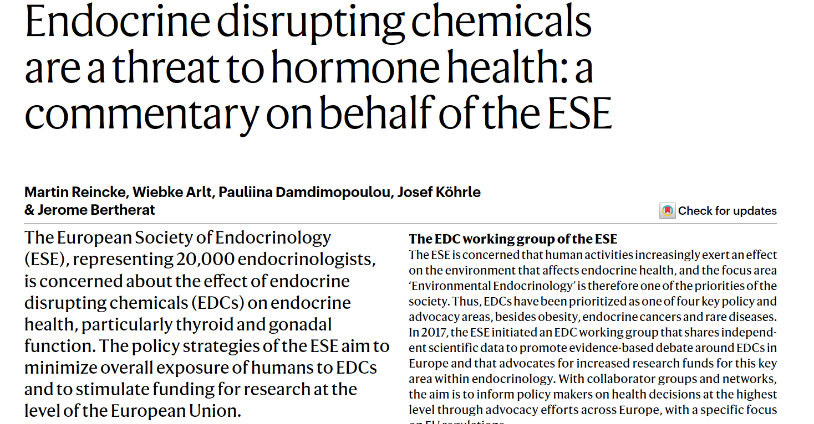
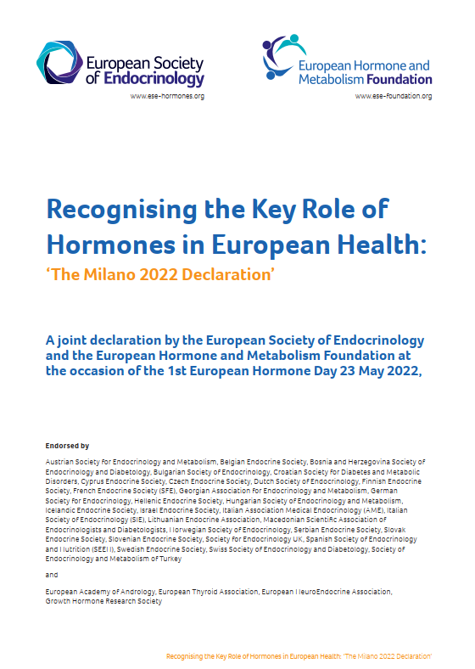



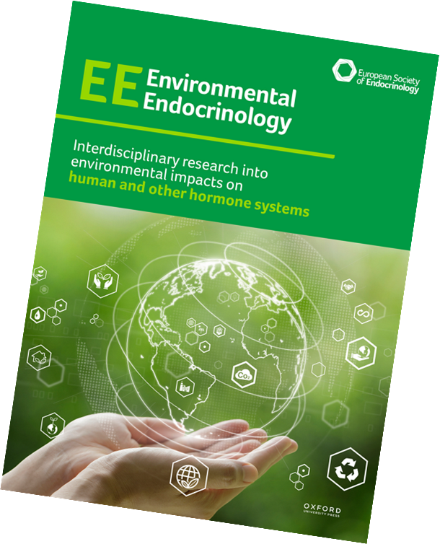

ESE and our health policy priorities informed by the ESE White Paper (2021)
2022
2024
Cancer
2025
EDC’s
  ¹ https://www.ese-hormones.org/media/3220/ese-white-paper_04052021-web.pdf
Notes:
Begin with the beginning – already active in EDC policy since 2012, but 2018 turning point to consider policy and advocacy as a strategic pillar for the society – Shape the future of endocrinology – shaping the external environment.
Milestone reached in 2021 by the publication of the White Paper, which we keep alive and focused through eg Milano declaration 2022 and the Annex 2023 to add a public awareness perspective to what we do.

Slide 4

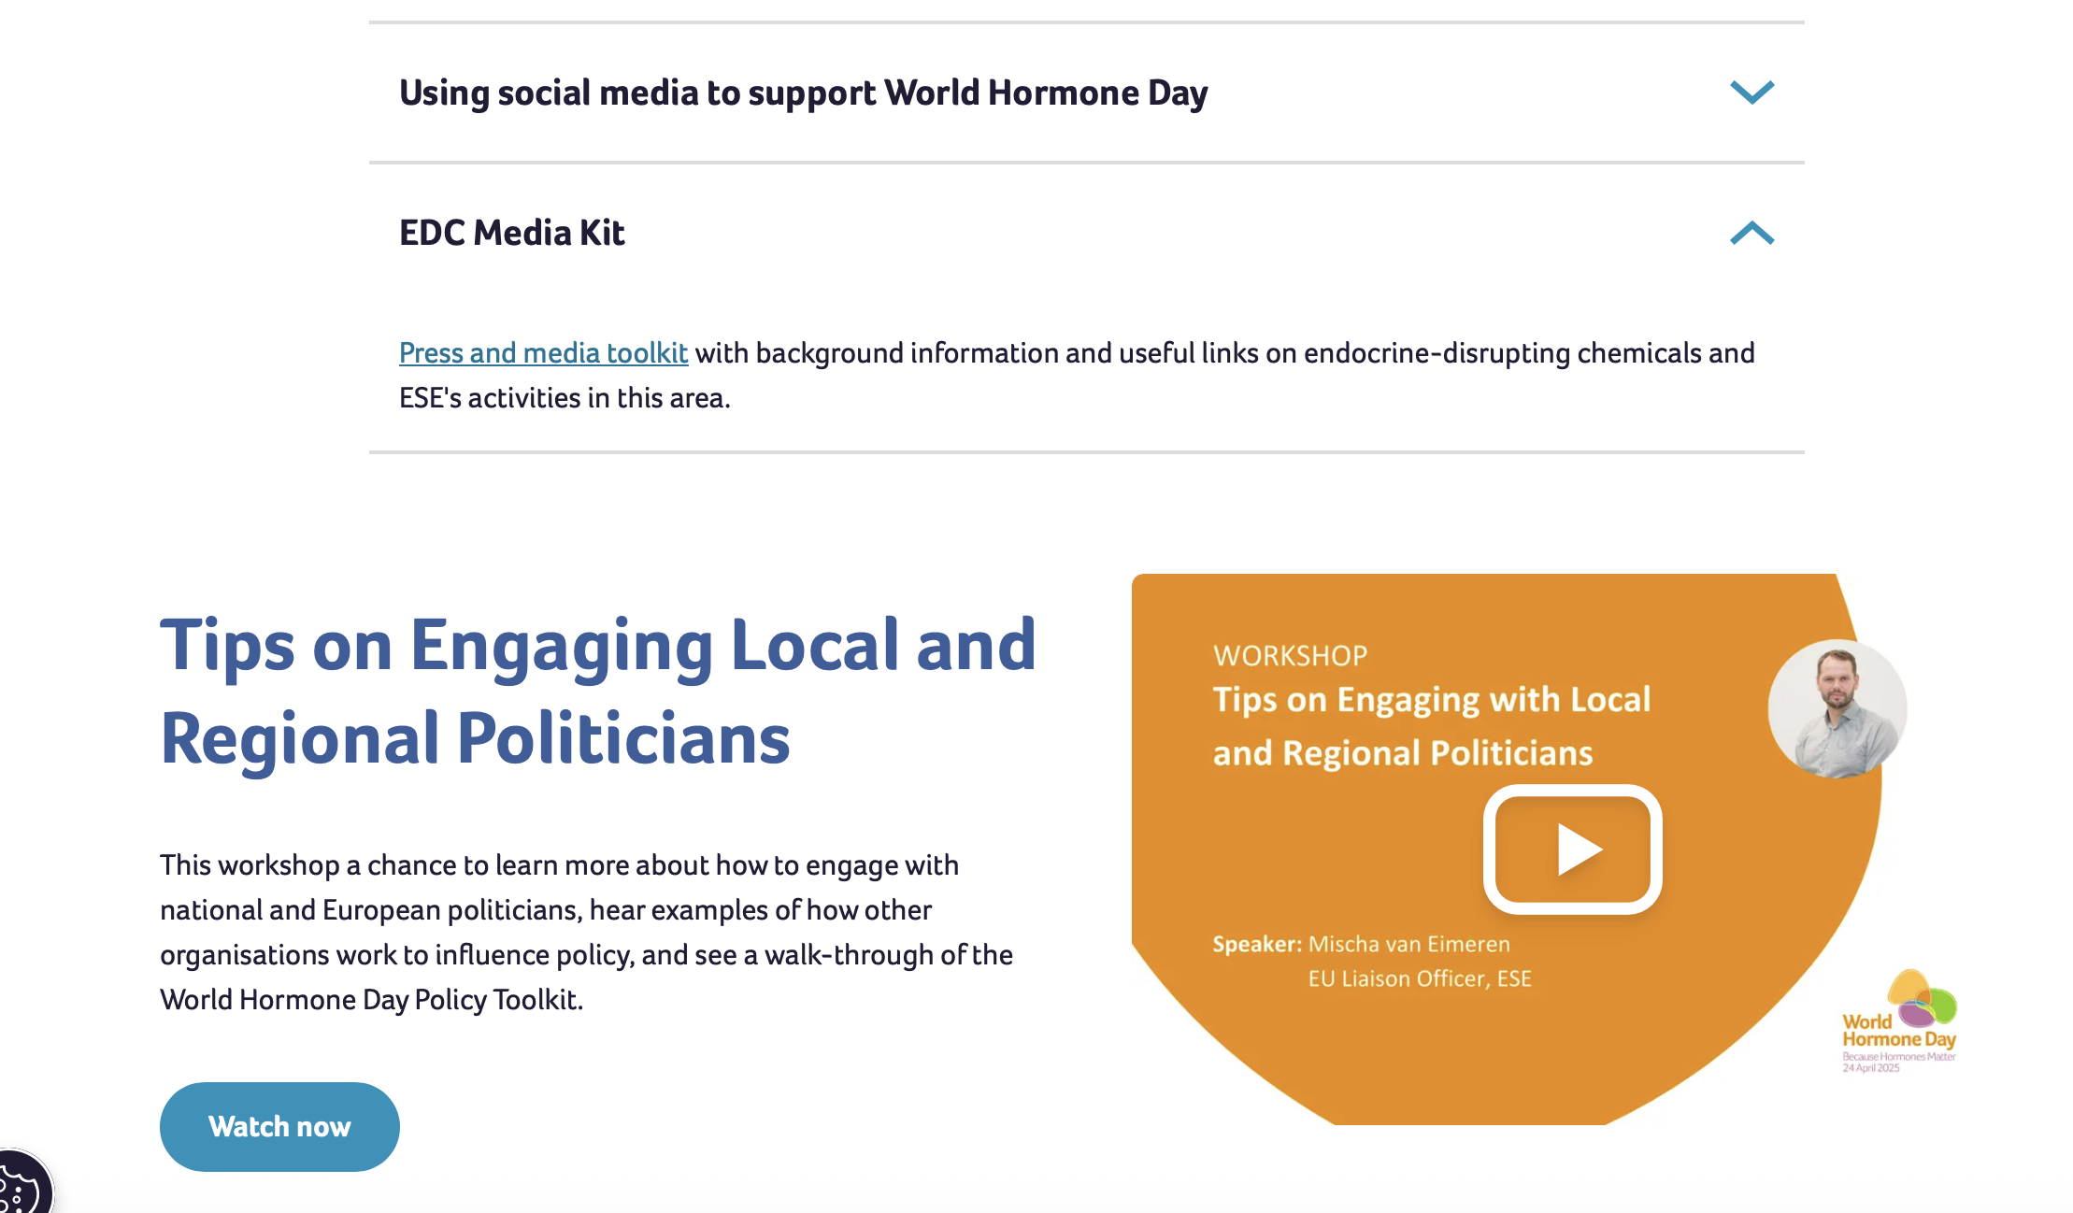

Slide 5
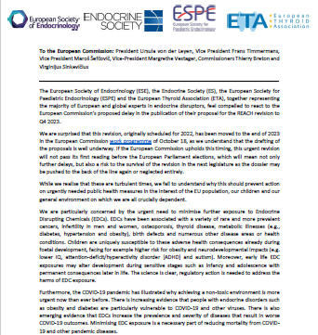

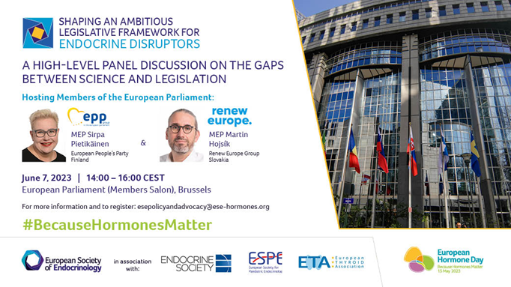
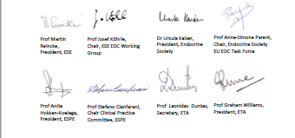

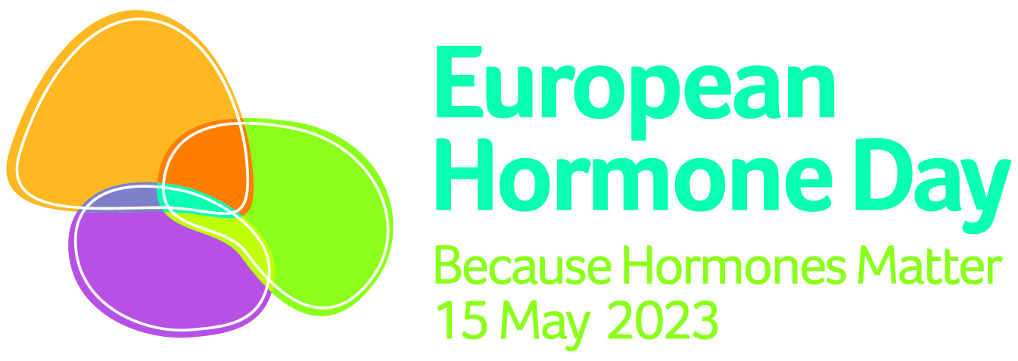
Working together to address the EDC challenge
Supporting the REACH* legislative proposal through policy outreach
The REACH* revision is a critical step towards the necessary measures needed to reduce exposures to hazardous EDCs.
Open Letter November 2022
March 2023
7 June 2023
Q3-Q4 2023/2024
Social media based on June 7 event
PFAS consultation
Toys regulation
5th EDC Forum (Brussels)
SIGN NOW!
Endorsement of 42 societies
Followed by petition of the ESE PAGs group
Event at European Parliament
*REACH: Restriction, Evaluation, and Authorisation of Chemicals

Slide 6

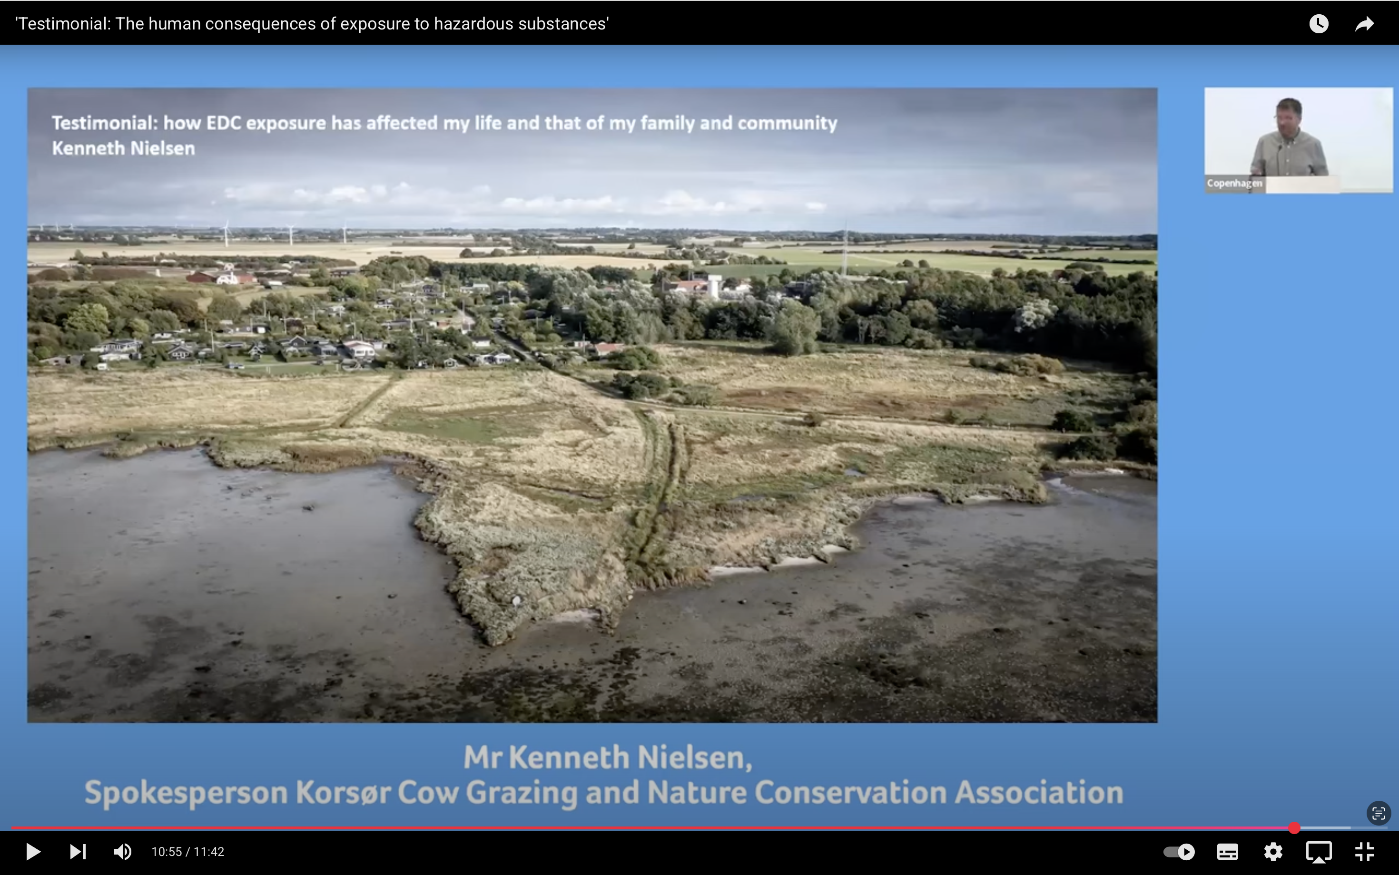

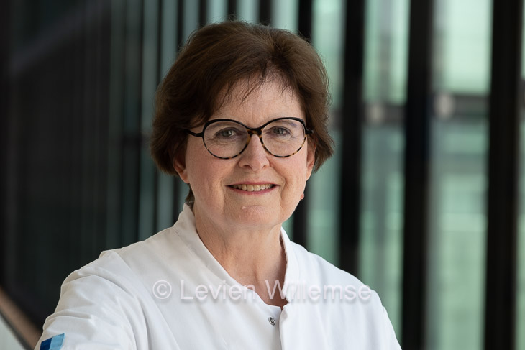
A Scientific Update following the Joint Congress of ESPE and ESE 2025
Welcome
ESE President
ESPE President
Thank you to all our event partners:
Notes:
Jérôme: On behalf of the European Society of Endocrinology I would like to welcome you to this high-level Event on Endocrine Disrupting Chemicals. This event is a legacy event in the sense that we as an endocrine community would like to leave something positive…. or a legacy……behind in the city and country where over the past few days we held our first joint congress with the European Society for Paediatric Endocrinology. Also, we feel a very strong urge and responsibility within the European endocrine community to continue making our scientific voice heard at the EU and national level to address the extensive health and environmental impact of endocrine disrupting chemicals. Also, in this more turbulent world we must continue to work together towards a better health and environment for all of us.

Slide 7

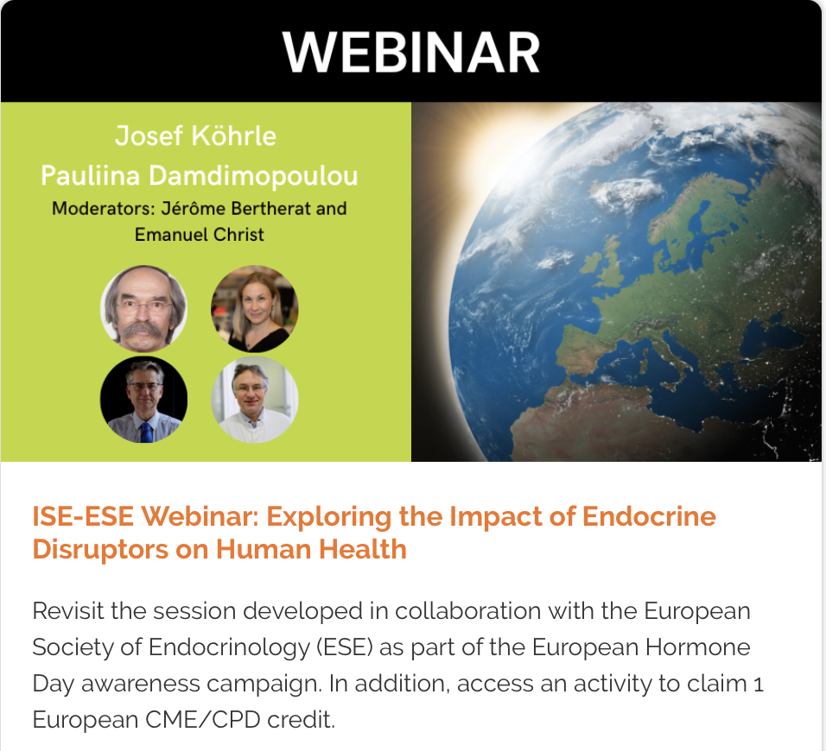
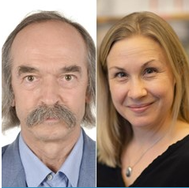
Josef Köhrle &
Pauliina Damdimopoulou
Environmental Endocrinology

Slide 8
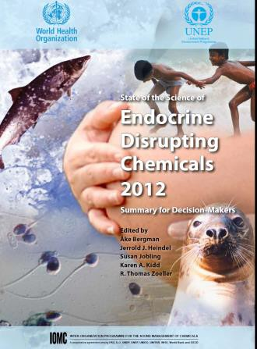
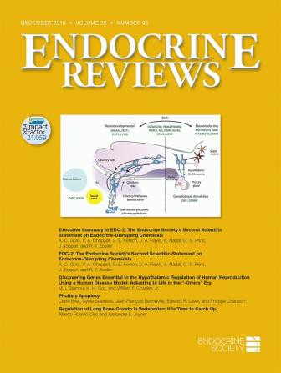
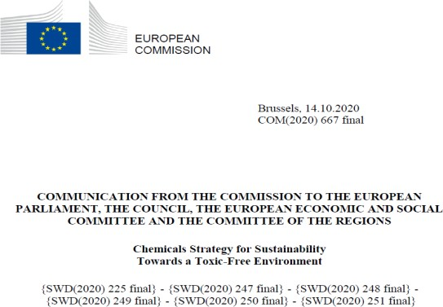
Definitions & Milestones
An endocrine disruptor is an exogenous substance or mixture that alters function(s) of the endocrine system and consequently causes adverse health effects in an intact organism, or its progeny, or (sub) populations (IPCS, WHO-UNEP, 2002)
A potential endocrine disruptor is a substance that possesses properties that might be expected to lead to endocrine disruption in an intact organism, or its progeny, or (sub)populations (IPCS, WHO- UNEP, 2002).
UNEP / WHO published the report “State of the Science of Endocrine Disrupting Chemicals” – 2012
“Endocrine-disrupting chemicals: an Endocrine Society scientific statement” (2009) & second statement (2015)
EU Commission: Chemicals Strategy for Sustainability Towards a Toxic-Free Environment (14. 10. 2020)
Endocrine-Disrupting Chemicals: An Endocrine Society Scientific Statement.
Evanthia Diamanti-Kandarakis, Jean-Pierre Bourguignon, Linda C. Giudice, Russ Hauser, Gail S. Prins, Ana M. Soto, R. Thomas Zoeller, Andrea C. Gore.
Endocrine Reviews, 2009, 30 (4), 293–342, https://doi.org/10.1210/er.2009-0002
Courtesy Prof J Kohrle
https://expendo.charite.de/

Slide 9
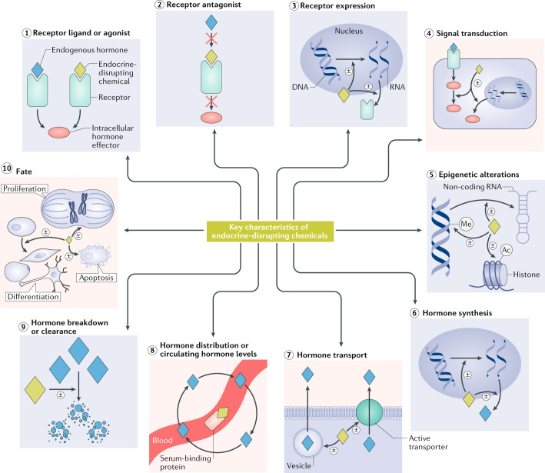
The key characteristics of endocrine- disrupting chemicals

Slide 10

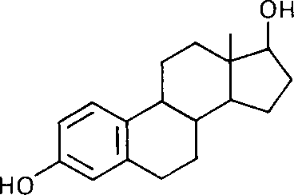
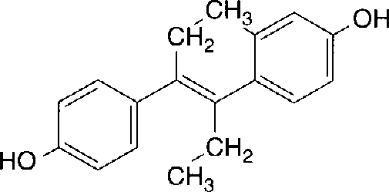
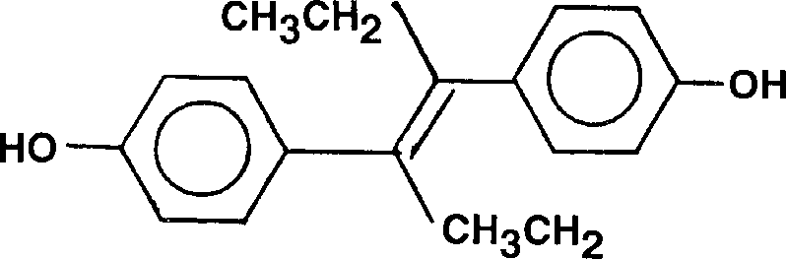
Diethylstilbestrol (DES): An Artificial Estrogen
IEÉ
EnForCé
1938: first synthetic agent specifically designed to have high estrogenic activity
prescribed widely in 1950s+ for difficult/complicated pregnancies
"Recommended for routine prophylaxis in ALL pregnancies... 96 per cent live delivery with desPLEX in one series of 1200 patients - bigger and stronger babies, too. No gastric or other side effects with desPLEX - in either high or low dosage." [1957]
≡
DES
estradiol-17β
Courtesy Prof J Kohrle
https://expendo.charite.de/

Slide 11


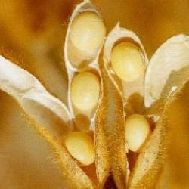


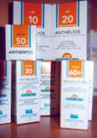


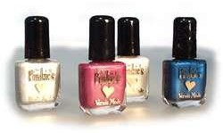
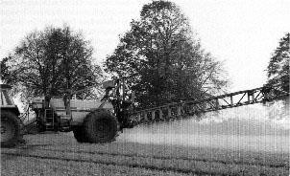


ENDOCRINE DISRUPTING CHEMICALS (EDC)
groups
synthetic chemicals from industry, agriculture, consumer products synthetic chemicals in cosmetics and pharmaceuticals
natural plant products („phytoestrogens“, isoflavones, goitrogens)
characteristics
stability in the environment mass production
accumulation in the food chain or body fat interference with hormone system & reproduction
Courtesy Prof J Kohrle
https://expendo.charite.de/

Slide 12
ENDOCRINE DISRUPTING CHEMICALS (EDC)
Per- and polyfluoroalkyl substances (PFAS) (persistant)
• Perfluorooctane sulfonic acid (PFOS)
• Perfluorooctanoic acid (PFOA)
• Perfluorononaoic acid (PFNA)
• Perfluorodecanoic acid (PFDA)
• Perfluoroundecanoic acid (PFUnA)
• Perfluorohexane sulfonic acid (PFHxS)
Organochlorine chemicals (persistant)
• PBDEs 47, 99, 153
• PCBs 74, 99, 118, 138, 153, 156, 170, 180, 183, 187
• Pesticides PeCB, HCB, a-HCH, b-HCH, gHCH, oxychlordane, trans-nonachlor, p,p’ -DDT, p,p’ –DDE
Additives in plastics and cosmetics (semi-persistant)
• Bisphenols
• Parabens
• Phtalates

Slide 13
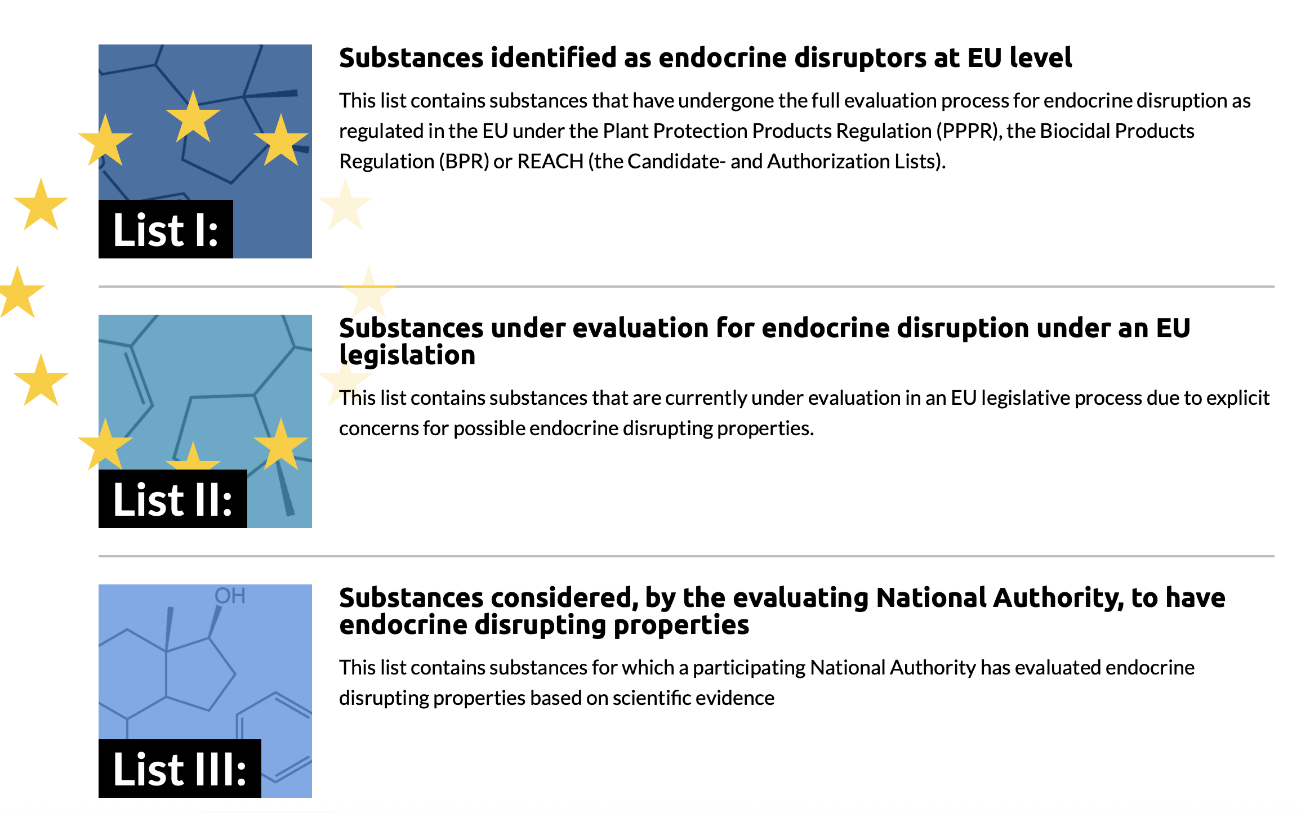
ENDOCRINE DISRUPTING CHEMICALS (EDC)
currently ca. 350 000 chemicals used in commerce somewhere
  75.000 mixtures, polymers and unknowns
  120.000 substances not unequivocally identifiable
~ 40 new chemicals discovered every hour!
Over 250 chemicals are listed by the European Union (EU) as known or suspected EDCs.
The estimated cost of delaying regulations is estimated to be 163 billion €/year in Europe alone, (underestimate as only a limited set of EDCs and health outcomes have been assessed)
.

Slide 14
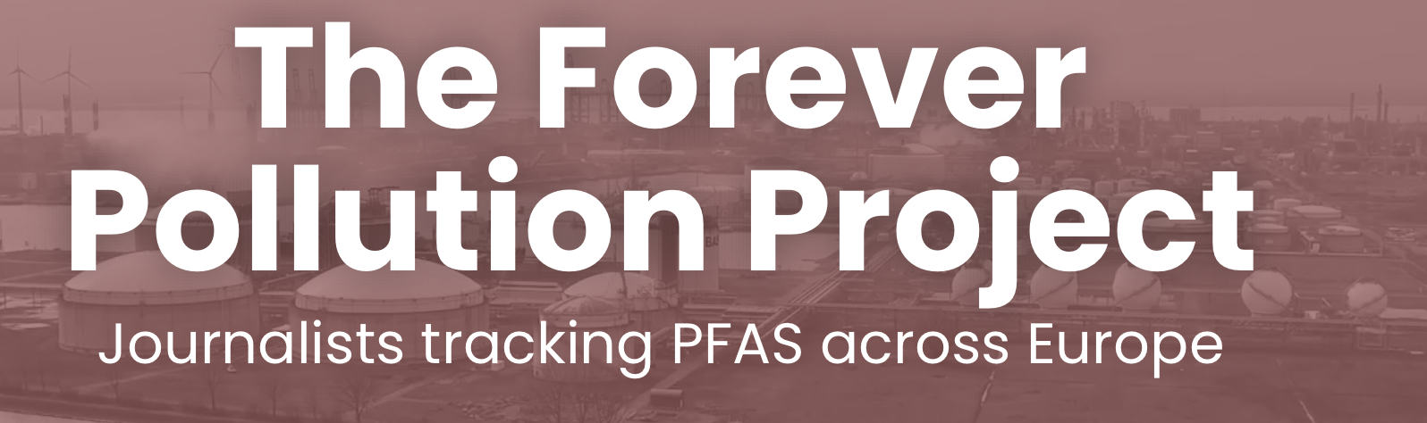
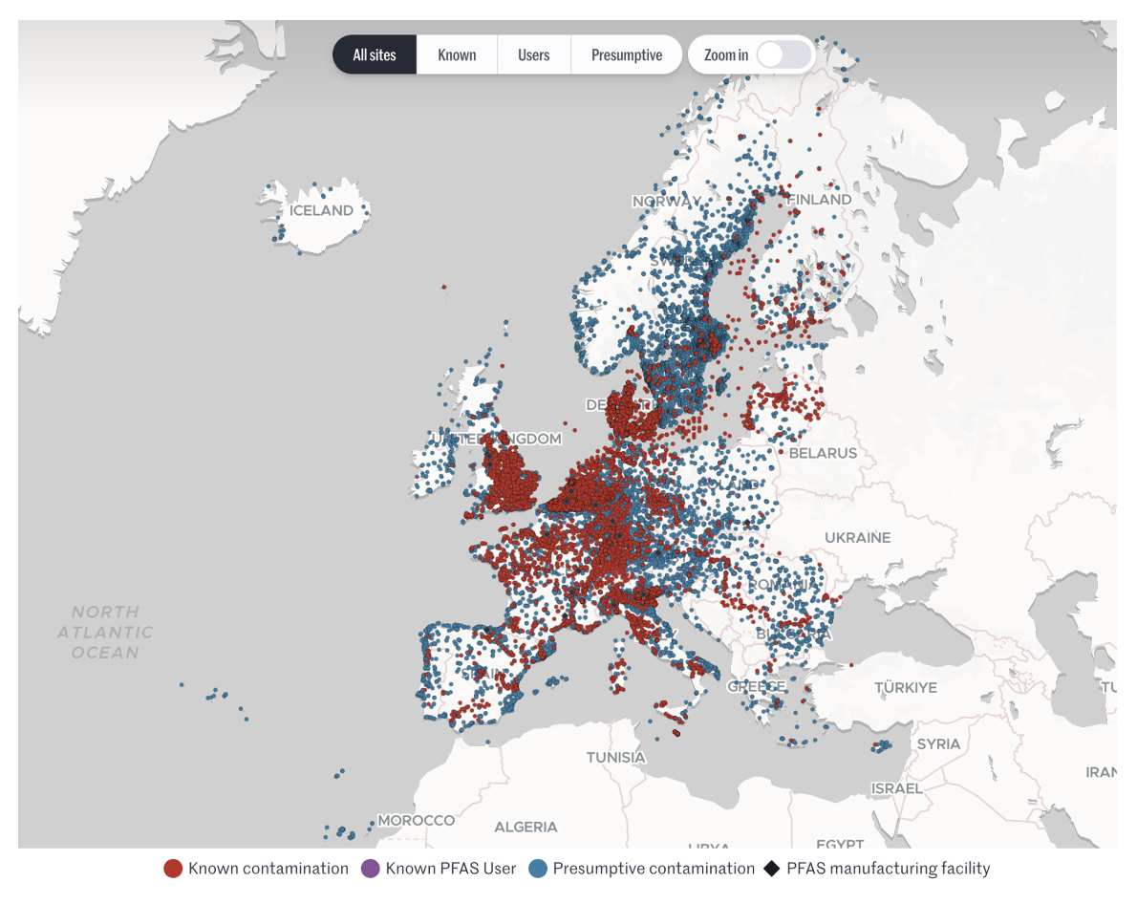

Slide 15

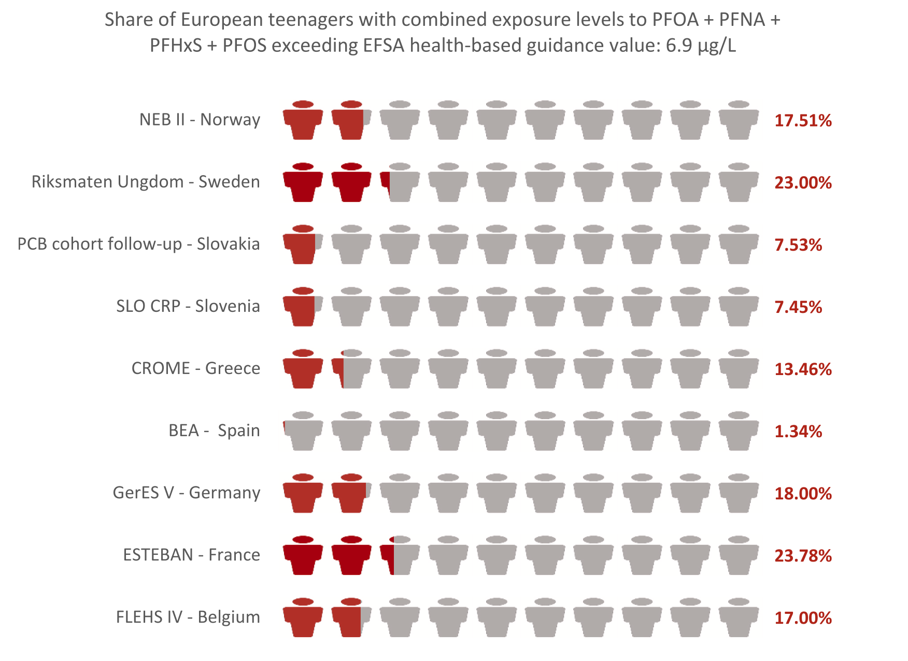
The Human Biomonitoring Initiative (HBM4EU)

Slide 16
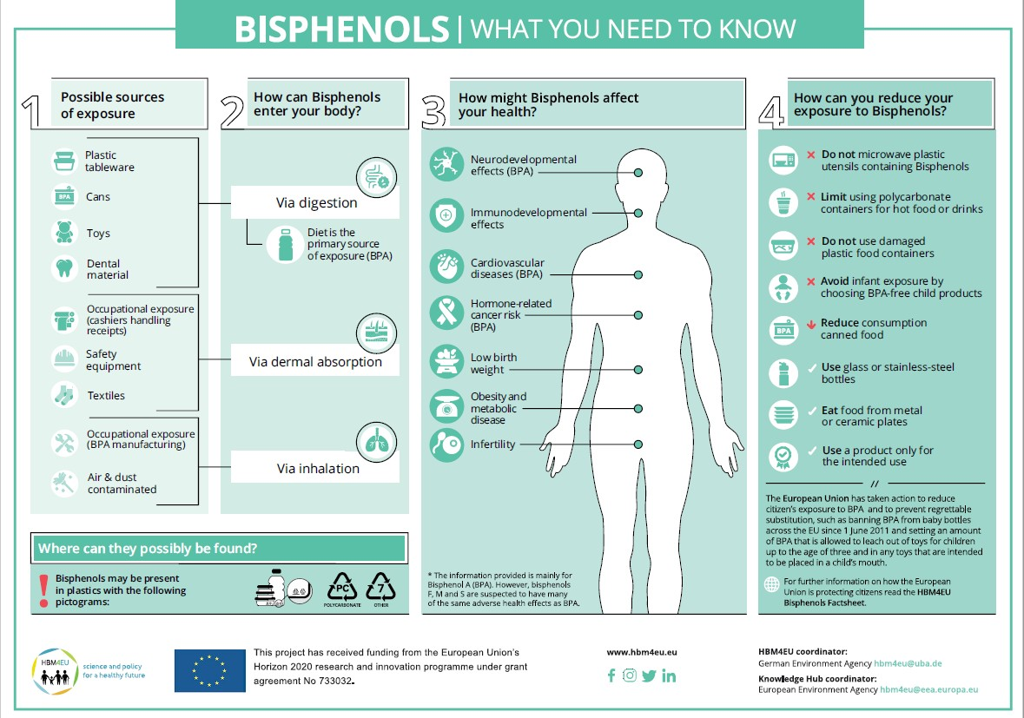

Slide 17
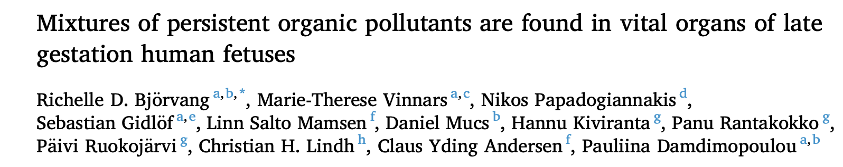
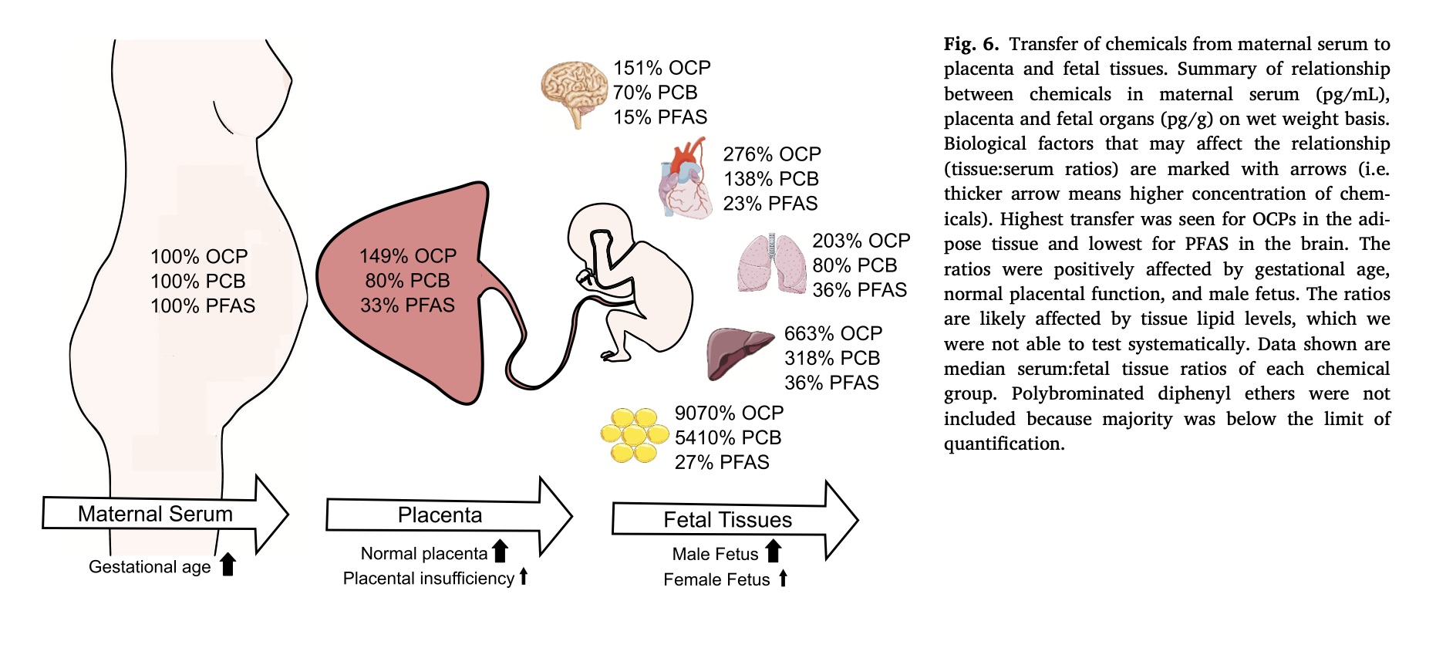
organochlorine pesticides (OCPs)
polychlorinated biphenyl (PCB)
polybrominated diphenyl ether (PBDE)
Björvang EDC MIX Chemosphere 283 (2021) 1311252021

Slide 18
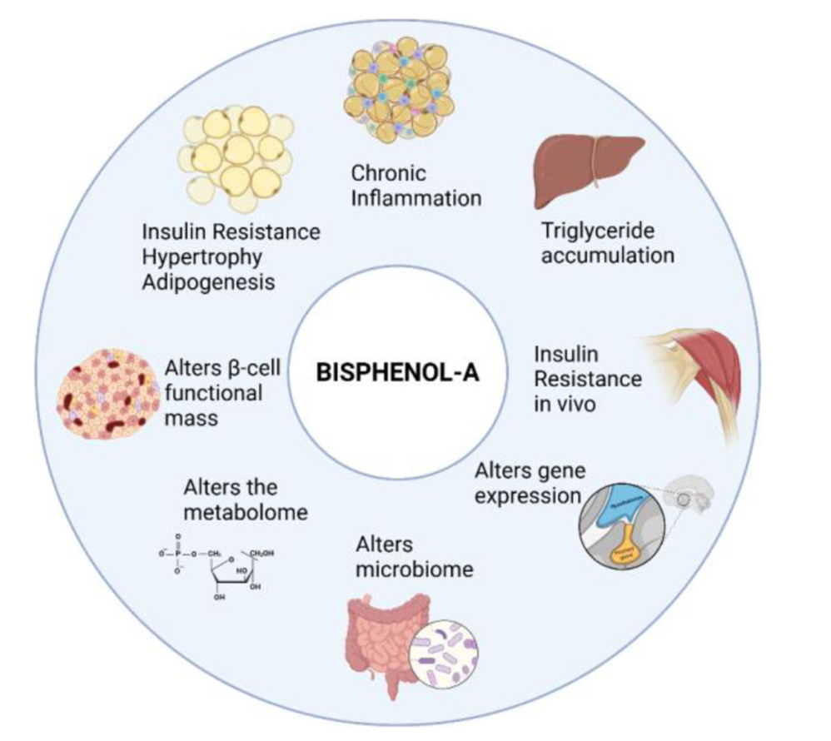
Bisphenol and metabolic diseases
A Nadal, Ann Endocrinol 2025

Slide 19
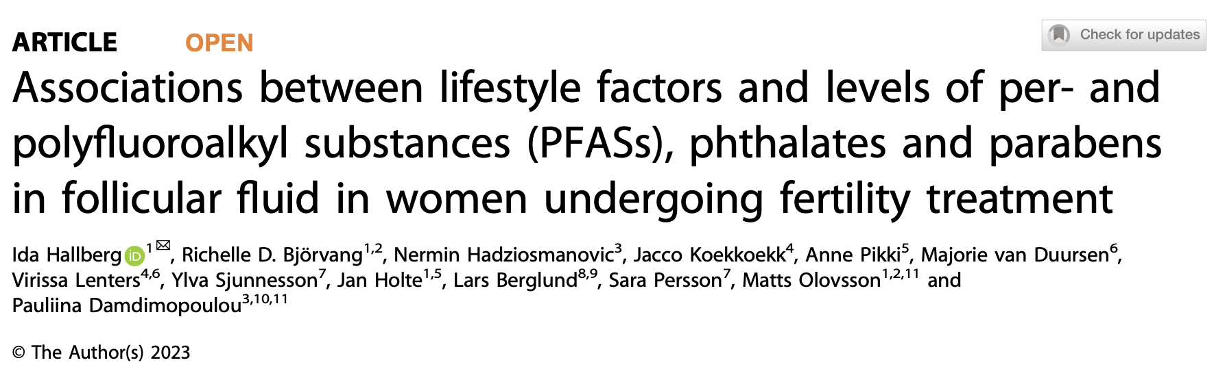
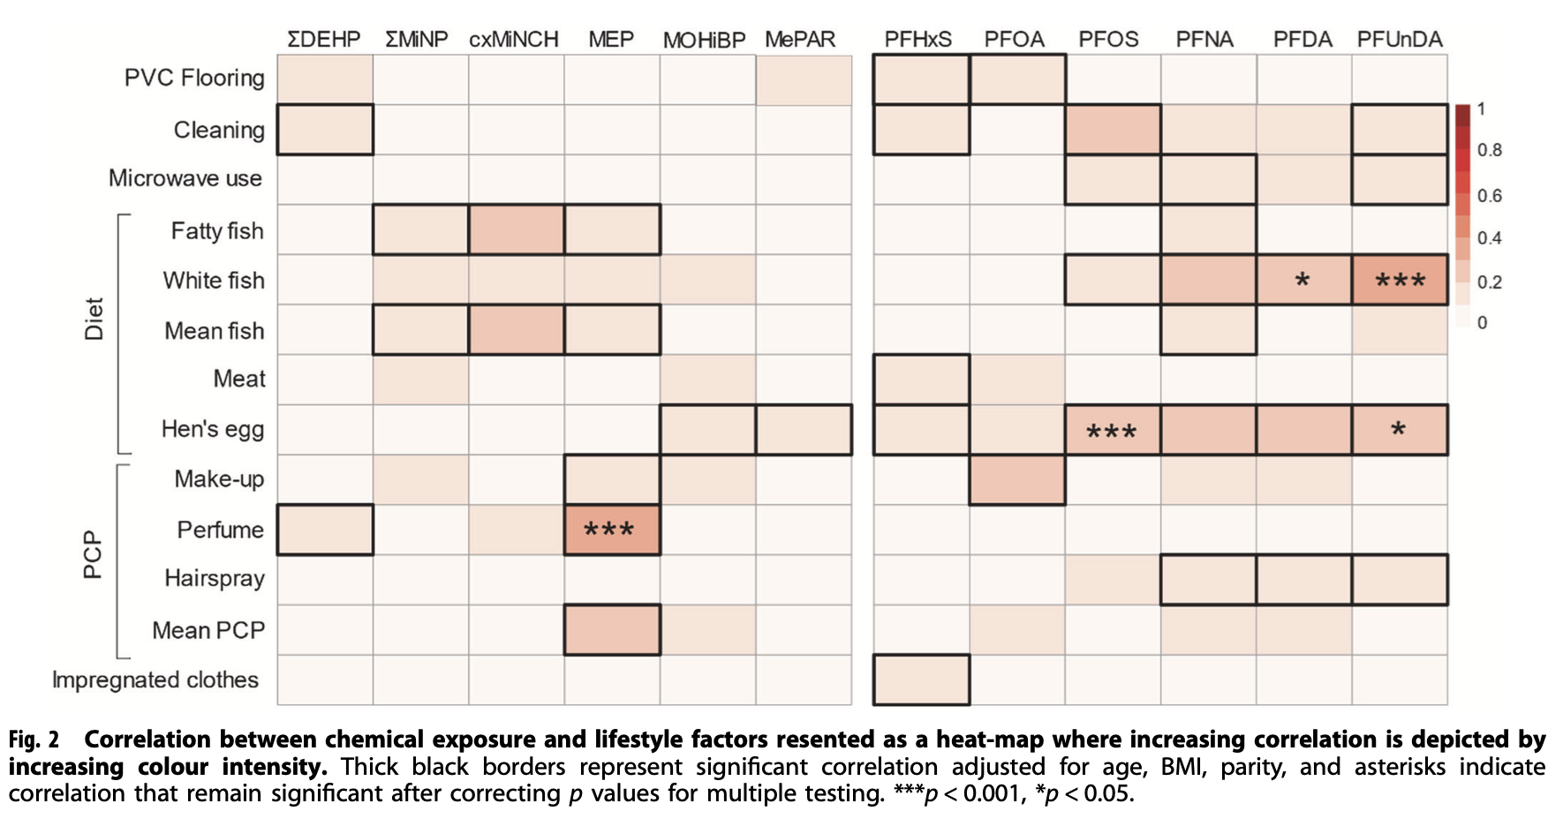
EDCs and ovaries
Journal of Exposure Science & Environmental Epidemiology

Slide 20
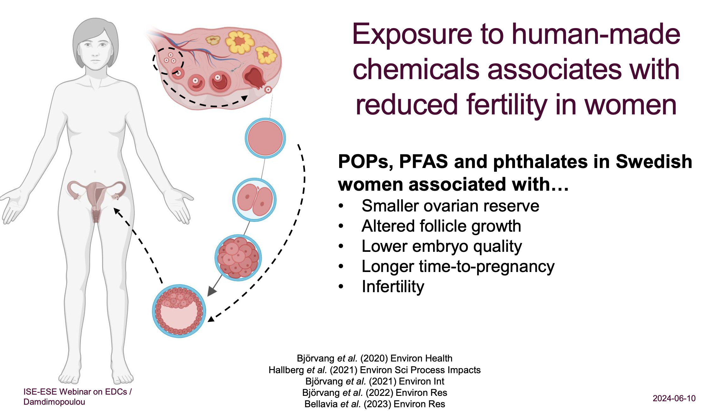
EDCs and ovaries
Courtesy Prof P Damdimopoulou

Slide 21
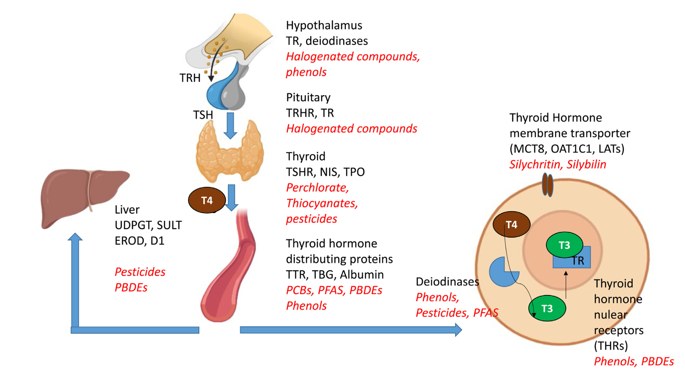
EDCs and Thyroid
A Herranen, Ann Endocrinol 2025

Slide 22
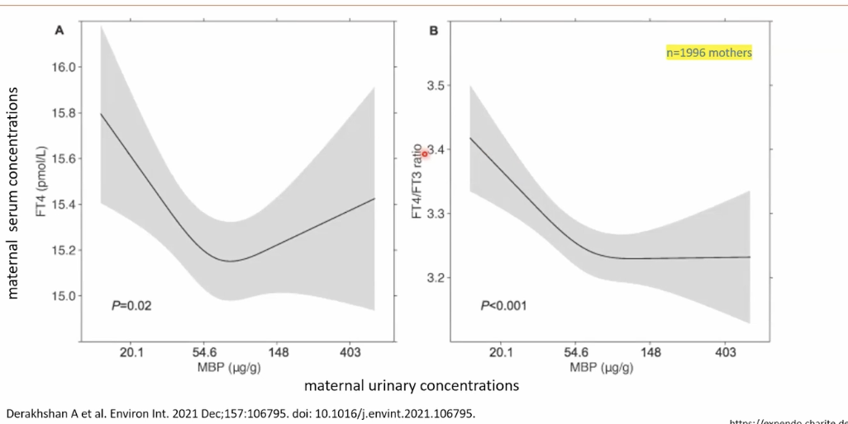
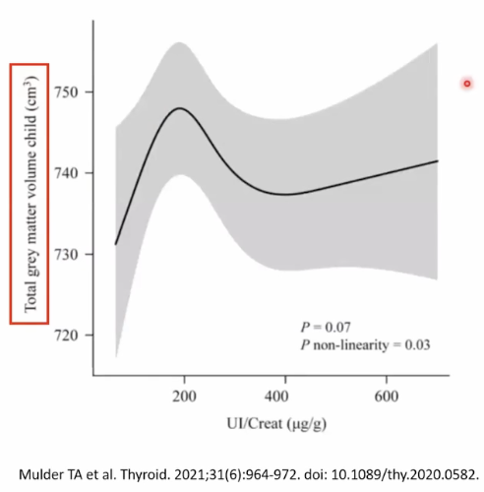
EDCs and Thyroid during pregnancy
Maternal U Iodine & Grey matter volume
Phtalates & TH

Slide 23
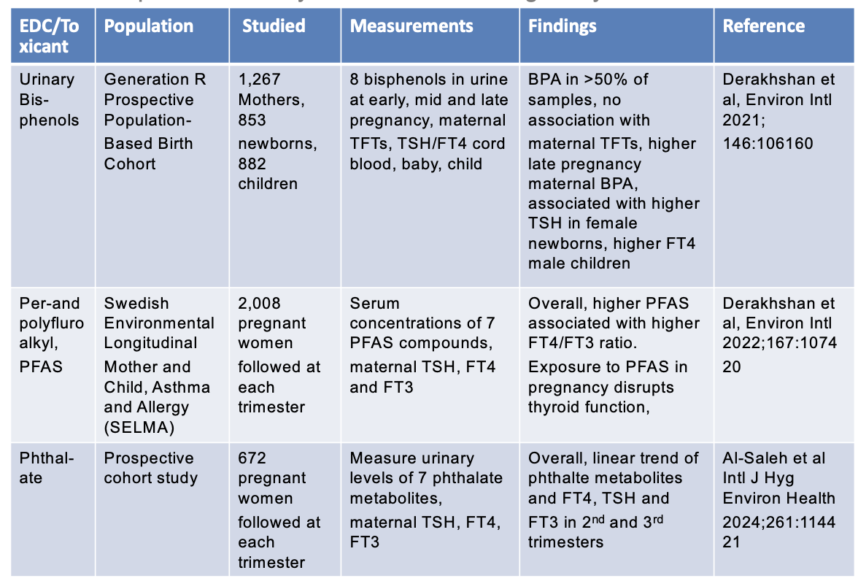
EDCs and Thyroid

Slide 24
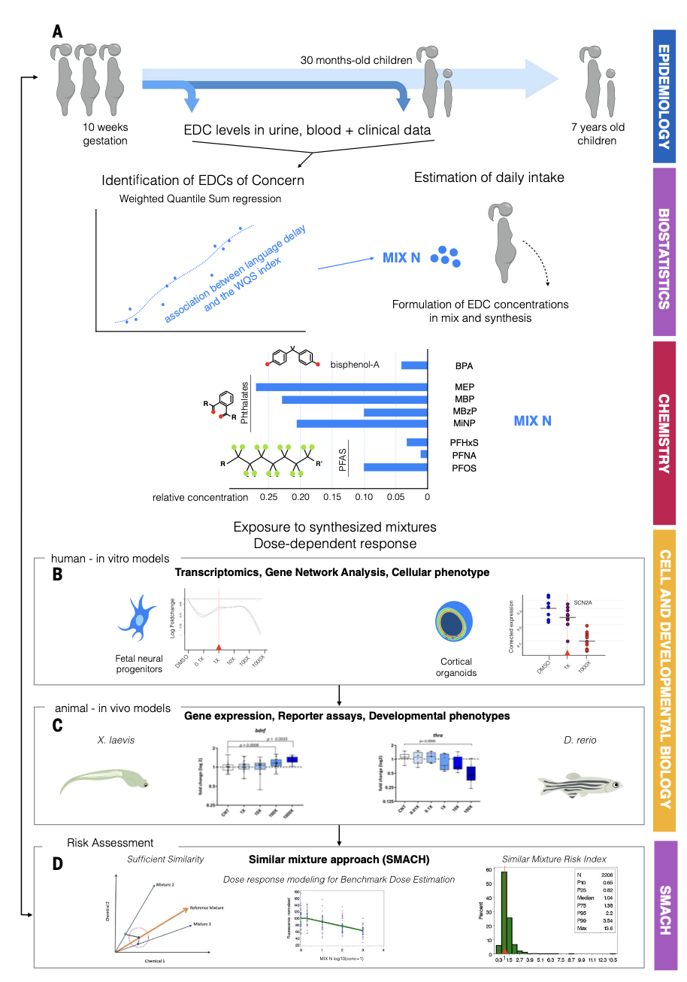
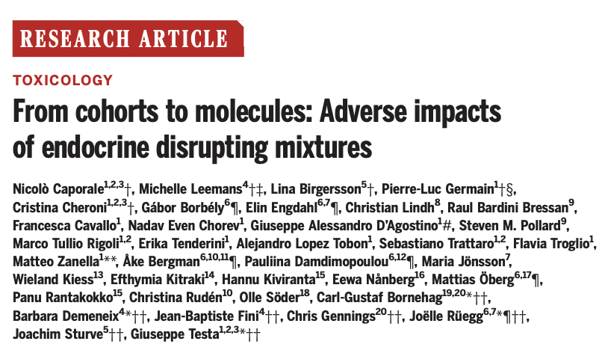
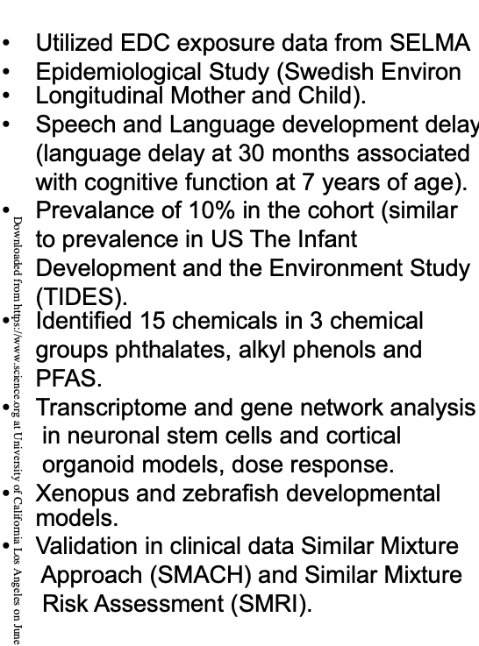
EDCs mixture: closer to the reality ?
Order of hormonal targets
in the network: thyroid > estrogen > PPAR > progesterone > androgen > corticoid > retinoic, reflecting the overall number of DEGs identified.

Slide 25
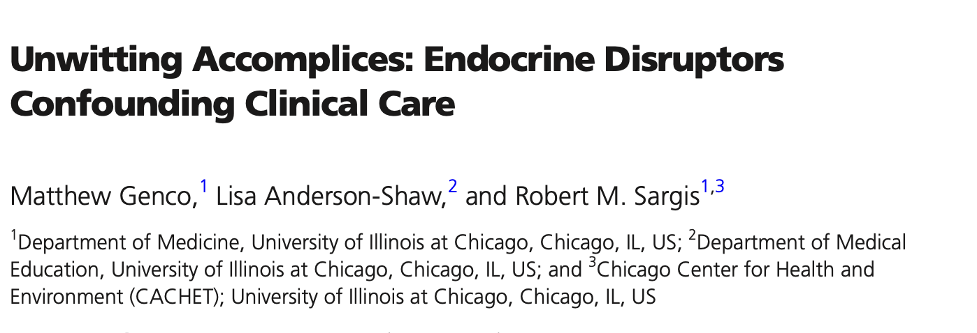
EDCs in health care
Drugs:
  Galenic process
  Drug coating
  Stabilizers/antioxydants/preservative
  Liquid drugs
i.v. systems:
  Soft tuning , catheters, medical devices
  Intensive care
  Neonatal intensive care for permature babies

Slide 26
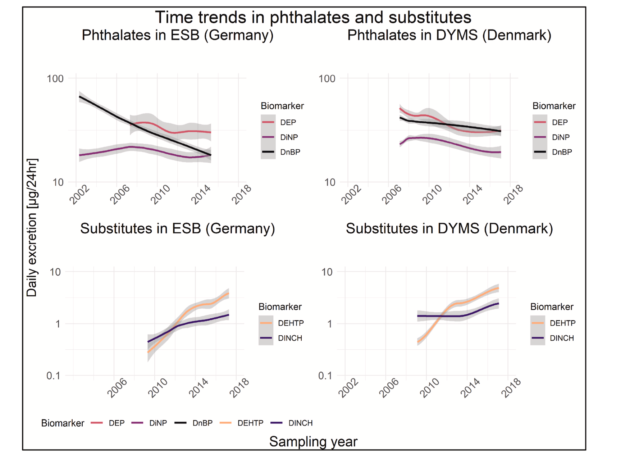
How to reduce exposure: regulation is effective
The Human Biomonitoring Initiative (HBM4EU)

Slide 27
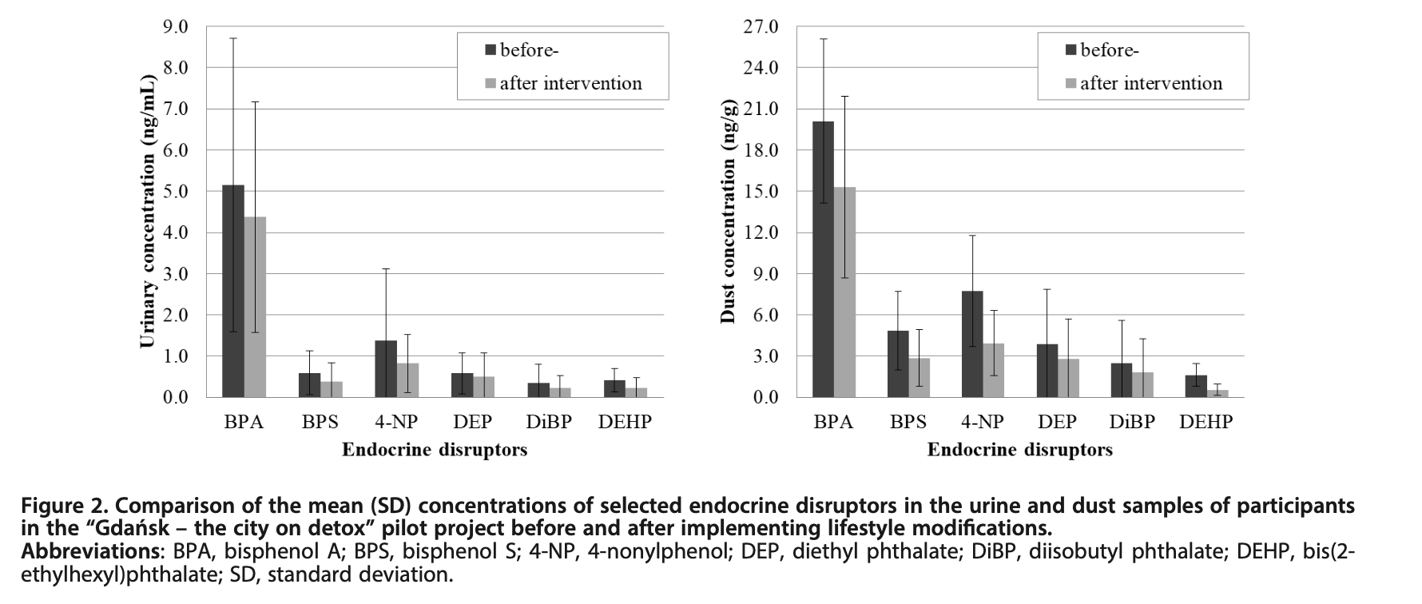
How to reduce exposure: life style modification is effective
A Rutkowska, et al, 2020

Slide 28
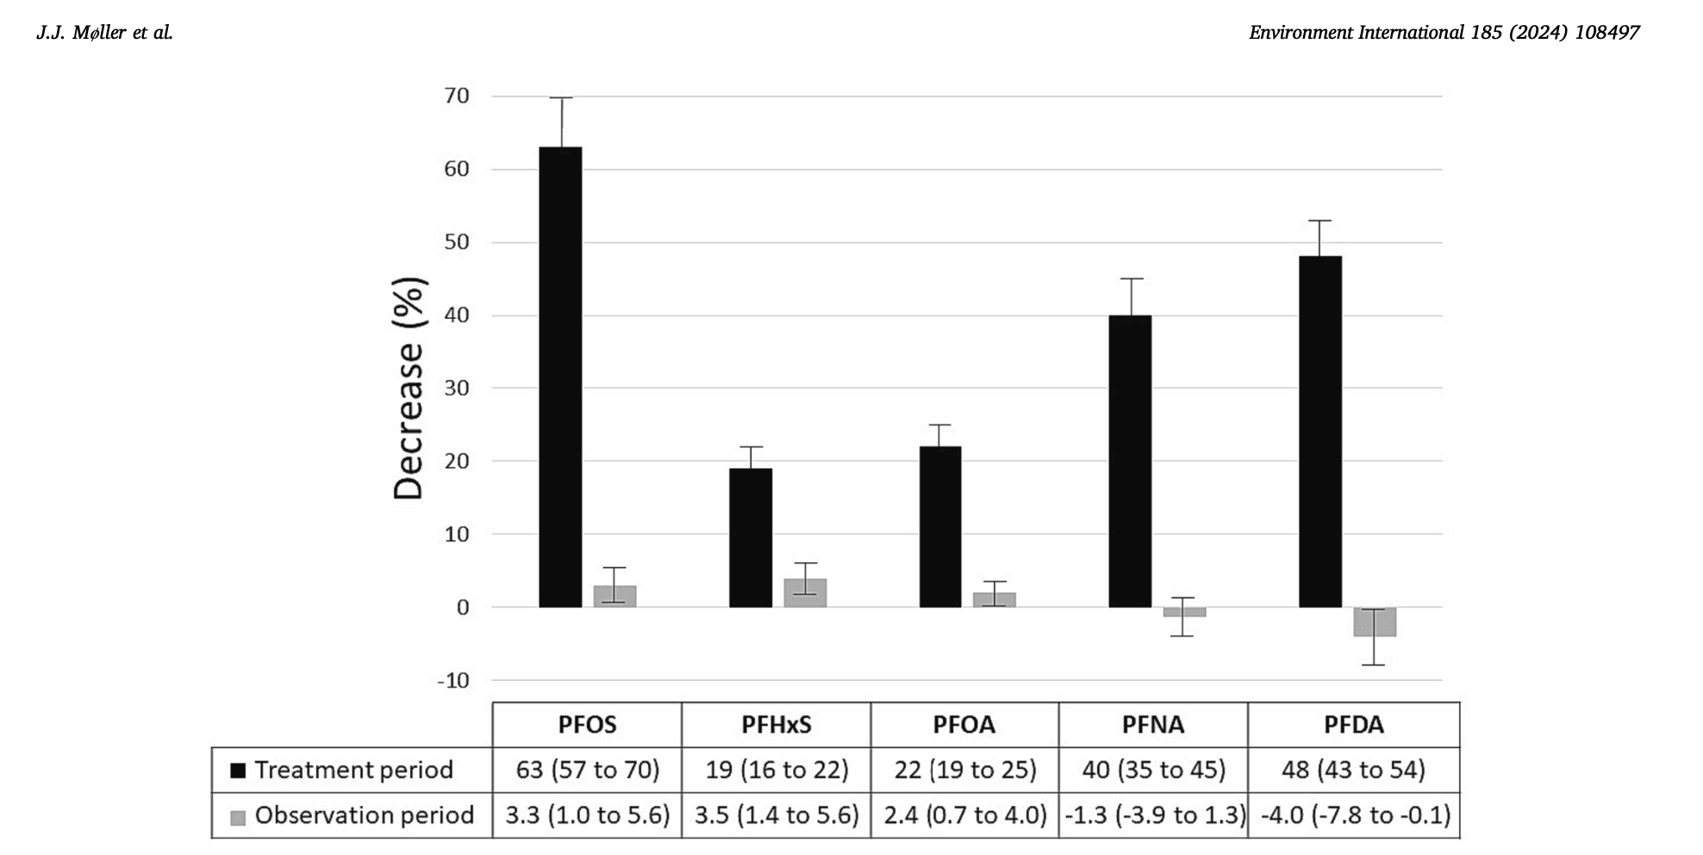
How to reduce exposure: individual approache
Randomized treatment sequence crossover study with anion exchange resin treatment
(cholestyramine 4 g three times daily) or observation for 12 weeks was conducted among citizens from a PFAS hotspot.

Slide 29
Conclusion
Perturbateurs endocriniens: c’est une réalité !
in silico ➔ in vitro ➔ ex vivo ➔ in vivo ➔ épidémiologie
Femmes enceintes parmi les sujets les plus à risque
Approche individuelle peut être efficace pour réduire l’exposition
La réduction de l’exposition globale des populations/environnement par la réglementation est indispensable (prioritaire pour les substances classées à haute préoccupation)

